Slide 1
Managing NymBoxes for Identity and Tracking Protection
David Wolinsky, Daniel Jackowitz, and Bryan Ford
Yale University

Slide 2






Surfing the Web
Doesn’t want her ISP to know her activities
Wants to access some services under a pseudonym
Others anonymously
Internet
Alice’s Laptop
Alice

Slide 3

Surfing the Web Anonymously
Tor offers anonymous communication
Adversary could target Tor
Adversary prefers the user environment
Internet
Alice’s Laptop
Alice

Slide 4
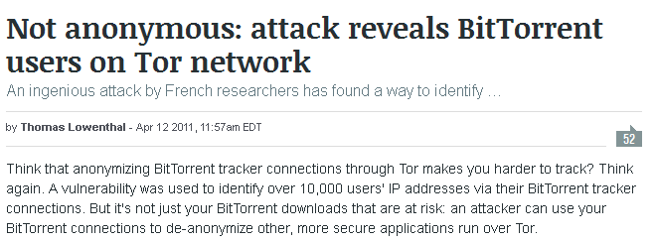
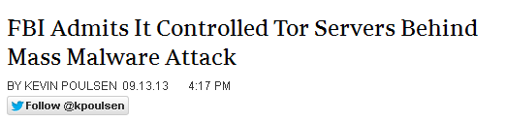
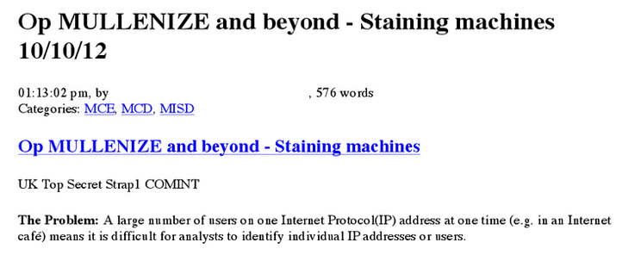
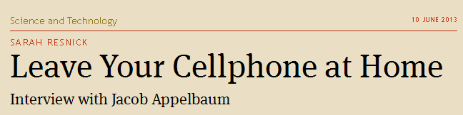
The Leaky Boat
Adversary focuses on breaking the user environment not the tool….

Slide 5
Introducing Nymix
System enforced isolation
Amnesiac browsing sessions
Anonymous cloud storage
Cloud Storage
Internet
Alice’s Laptop
Nym
Nym
Alice
Nym

Slide 6
Outline
Attacks Against Privacy
Nymix Architecture
Defending Against Privacy Attacks
Evaluating Nymix
Future Directions

Slide 7
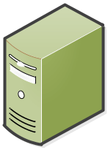


Application Level Attacks
Alice in Repressistan
Unsecured Channel:
“Here’s my IP”
Eve’s
Booby-trap
Alice’s Laptop
Blog
Tor-based Secure Channel
Alice
Freetopia
Repressistan
Javascript Exploit

Slide 8


Correlation Attacks
Bob of Freetopia
Internet
Bob’s Laptop
Bob

Slide 9




Confiscation Attacks
Carol the Landofopportunian
Carol
Border patrol

Slide 10
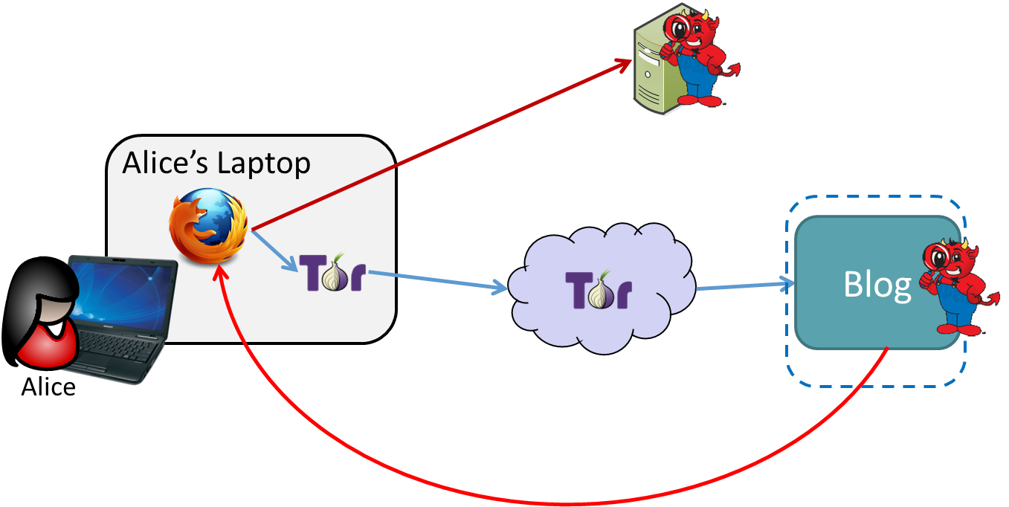
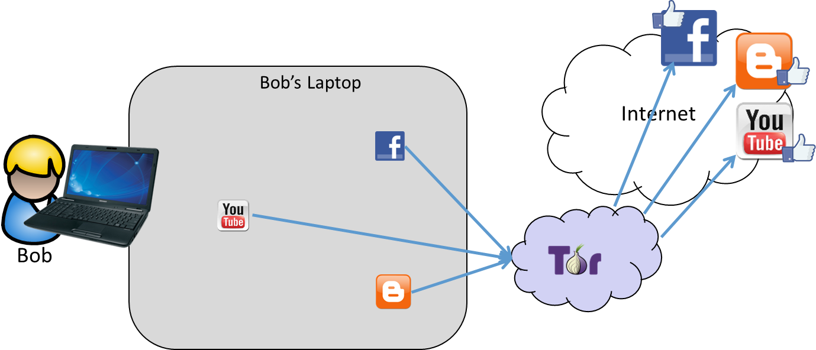
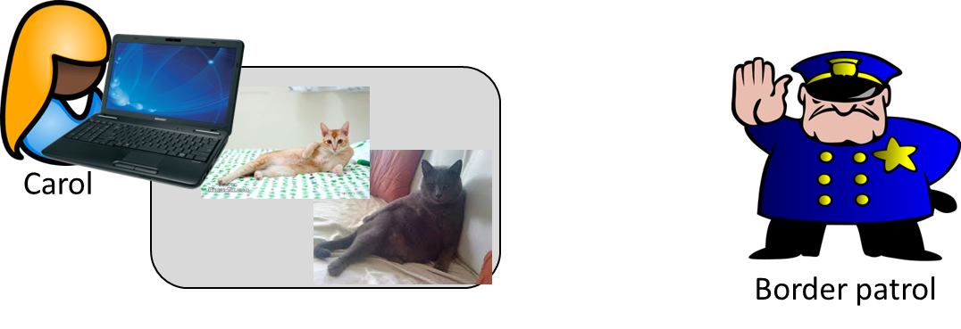
Attacks Recap
Application-Level
Correlation
Confiscation

Slide 11
Outline
Attacks Against Privacy
Nymix Architecture
Defending Against Privacy Attacks
Evaluating Nymix
Future Directions

Slide 12
Nymix
System enforced isolation
Amnesiac browsing sessions
Anonymous cloud storage
Data Sanitization
Cloud Storage
Internet
Alice’s Laptop
Nym
Nym
Alice
Nym

Slide 13
Ephemeral Nym
Each Nym starts from the same base state
Separate VMs to enforce sandboxing in AnonVM
Securely erased upon exit
Internet
Alice’s Laptop
Nym
Alice
AnonVM
CommVM

Slide 14


Long-Lived Nyms
Desire persistent state
Resetting CommVM state can weaken anonymity¹
Anonymously store/restore from cloud
Internet
Alice’s Laptop
Nym
Alice
AnonVM
CommVM
¹A. Johnson, “Users Get Routed: Traffic Correlation on Tor by Realistic Adversaries”, CCS 2013

Slide 15
Long-Lived Nyms
Retrieve disks from cloud
Close Nym
Restore long-lived nym
Internet
Alice’s Laptop
Nym
Alice
AnonVM
CommVM

Slide 16


Sharing Data – Sanitization
No local data directly in a Nym
Each Nym has associated Sanitization VM
Process:
  User selects file
  Prompted for cleaning method
  Results appear in Nym
Alice’s Laptop
User Data

Slide 17
Outline
Attacks Against Privacy
Nymix Architecture
Defending Against Privacy Attacks
Evaluating Nymix
Future Directions

Slide 18
Attacks Executed in Nymix
Application-Level
Correlation
Confiscation

Slide 19
Application Level Attacks
Alice in Repressistan
Unsecured Channel:
“Here’s my IP”
Eve’s
Booby-trap
Alice’s Laptop
Blog
Tor-based Secure Channel
Alice
Freetopia
Repressistan
Javascript Exploit

Slide 20
Application Level Attacks
Alice in Repressistan
Eve’s
Booby-trap
Alice’s Laptop
Secured Channel:
“Here’s my Tor IP”
Blog
Tor-based Secure Channel
Alice
Freetopia
Repressistan
Javascript Exploit

Slide 21
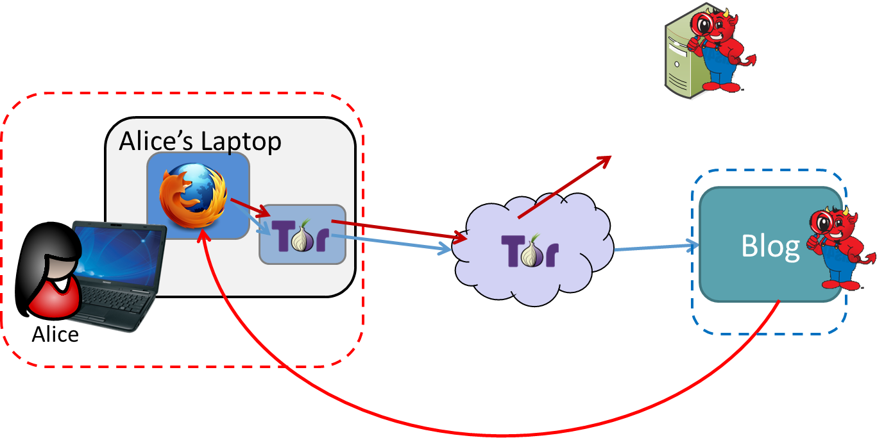

Attacks Executed in Nymix
Application-Level
Correlation
Confiscation

Slide 22
Correlation Attacks
Bob of Freetopia
Internet
Bob’s Laptop
Bob

Slide 23
Correlation Attacks
Bob of Freetopia
Internet
Bob’s Laptop
Bob’s Laptop
Nym
Nym
Bob
Nym

Slide 24
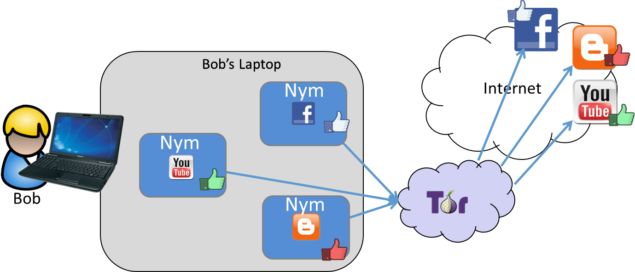
Attacks Executed in Nymix
Application-Level
Correlation
Confiscation

Slide 25
Confiscation Attacks
Carol the Landofopportunian
Carol
Border patrol

Slide 26
Confiscation Attacks
Carol the Landofopportunian
X
Border patrol
Carol

Slide 27
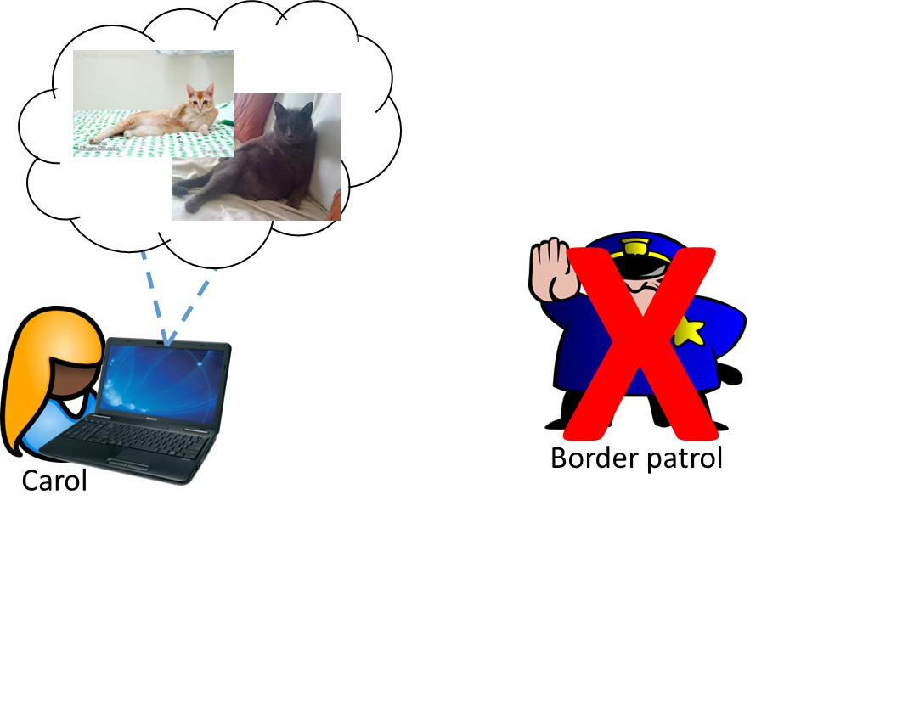
Attacks Executed in Nymix
Application-Level
Correlation
Confiscation

Slide 28
Outline
Attacks Against Privacy
Nymix Architecture
Defending Against Privacy Attacks
Evaluating Nymix
Future Directions

Slide 29
Implementation
Ubuntu 14.04
Qemu (KVM) for virtualization
OverlayFS for union file system
Google Chromium (required in order to support a circumvention software)

Slide 30
Evaluation
I7 – 4 cores at 2.7 GHz
8 GB Ram
Connects to a test deployment of Tor
  10 Mbit bandwidth
  200 ms latency
  3 relays
Nym memory usage
  AnonVM – 384 MB RAM, 128 MB Disk (stored in RAM)
  CommVM – 128 MB RAM, 16 MB Disk (stored in RAM)

Slide 31
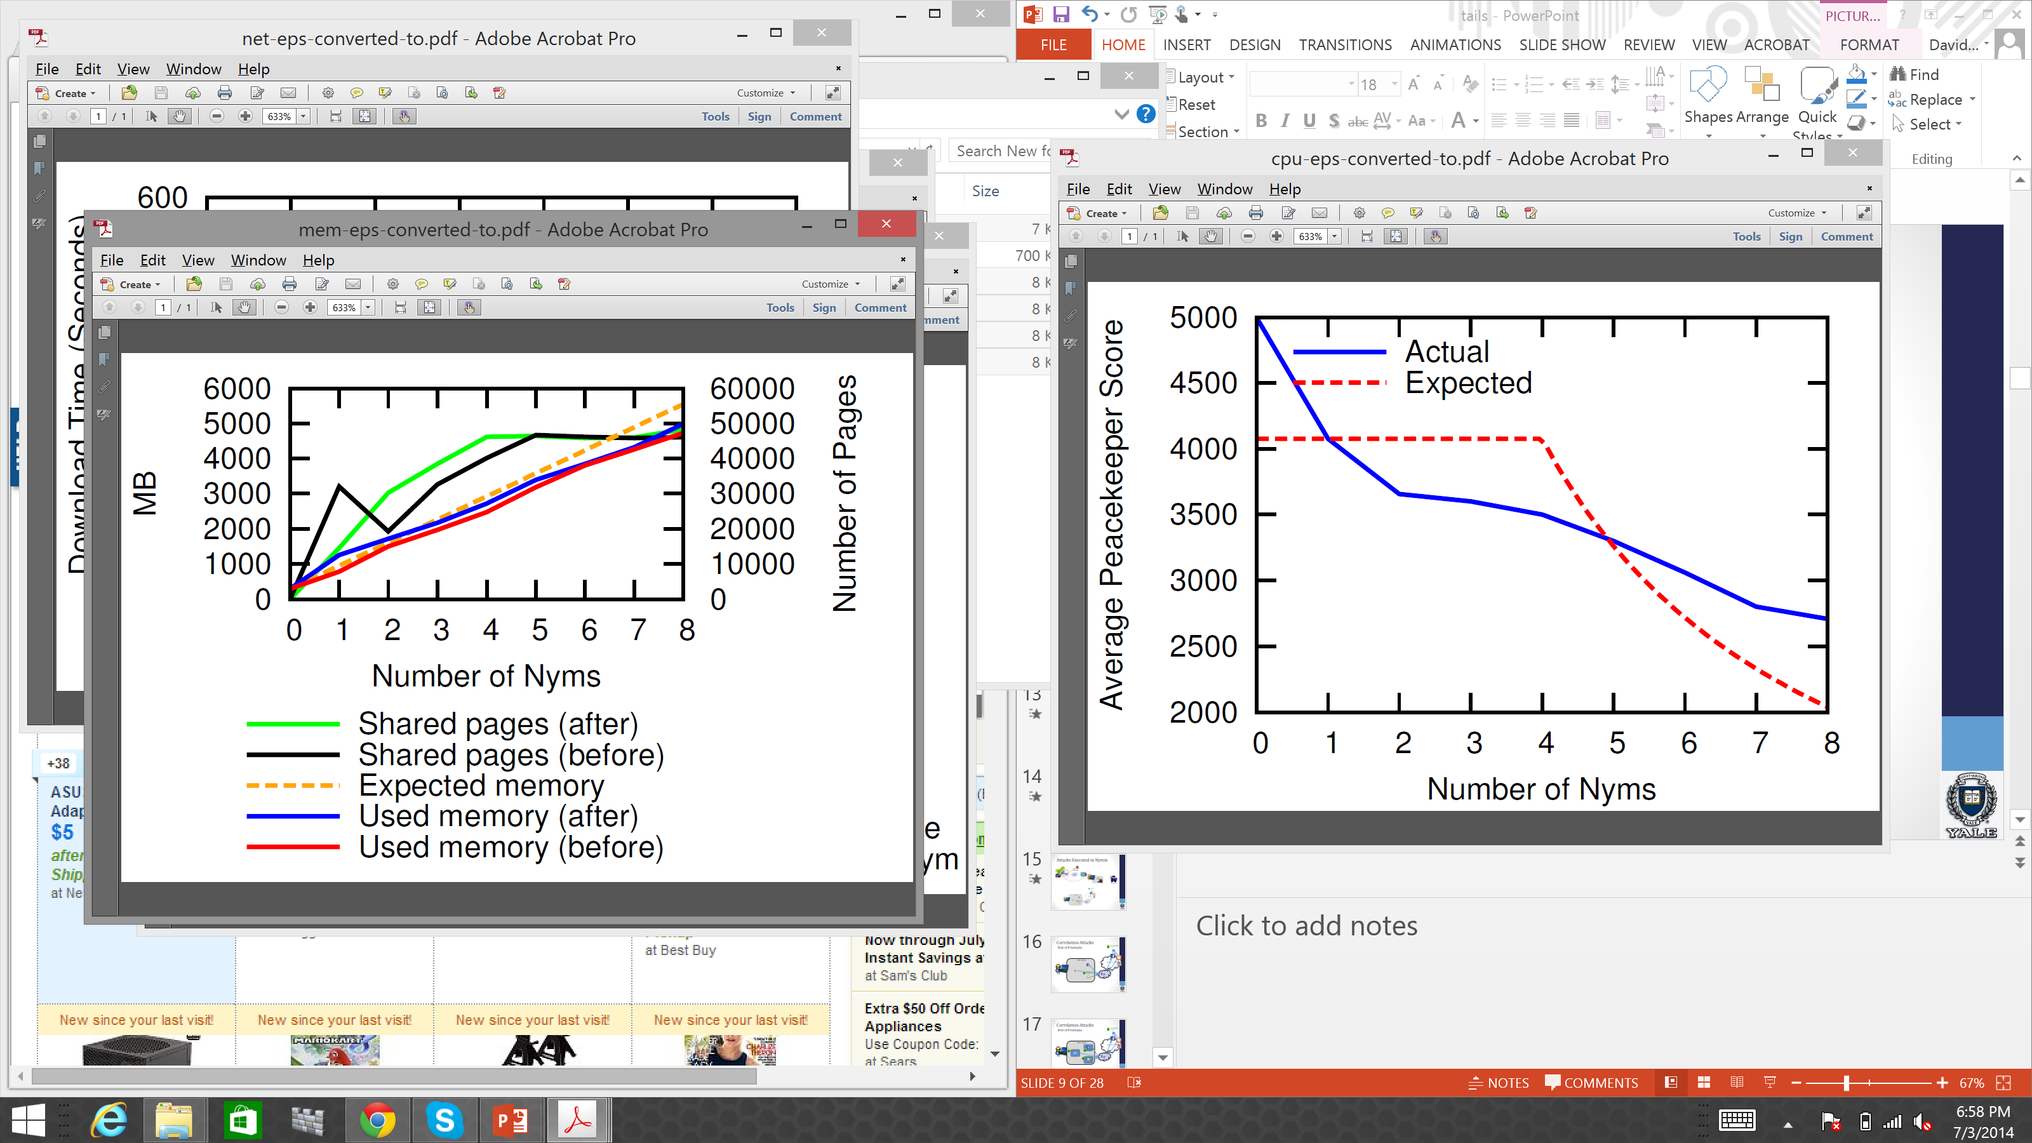
CPU Evaluations

Slide 32
Memory Usage

Slide 33
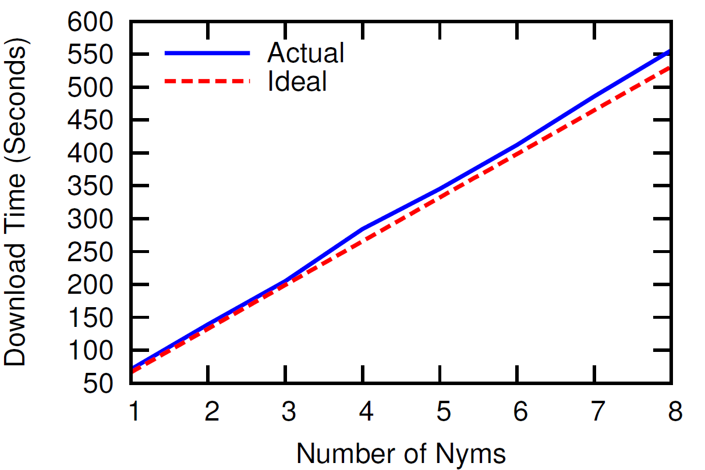
Network Overhead

Slide 34
Outline
Attacks Against Privacy
Nymix Architecture
Defending Against Privacy Attacks
Evaluating Nymix
Future Directions

Slide 35
Nymix is…
Not a complete solution
An exploration of pseudonymity potential with virtualization
A research prototype
Related work:
Tails – hardened, amnesiac
Whonix, Qubes – anonymity-enforced browsing

Slide 36
Integration
To CommVM or not CommVM
  Each VM is not cheap
  Must share a common Tor guard
Sharing a common base image
  Existing approaches are well hardened
  Many configurations undesirable for AnonVM
Persistence Models
  Store all data in the cloud
  Default encrypted volume header

Slide 37
Further Challenges
Fingerprintable CPU
VMM timing channels
Accessing local hardware
Storing data retrieved from the Internet

Slide 38
Conclusions
Lots of attacks against identity on the Internet
Nymix offers a practical solution to offering real pseudonymity on the Internet
Lots of attacks outside scope, integrate
Our website: http://dedis.cs.yale.edu/dissent/
Github https://github.com/DeDiS/WiNoN

