Slide 1
Enforcing Anonymity and Improving Pseudonymity in Tails
David Wolinsky
Yale University

Slide 2





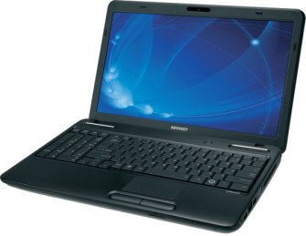

What Is Nymix
Cloud Storage
Nyms
Internet
Alice’s Laptop
Alice

Slide 3
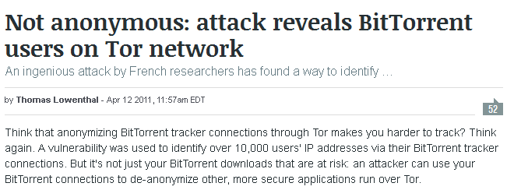
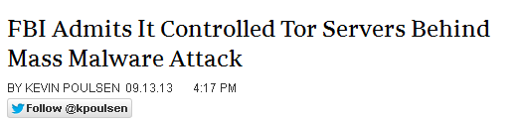
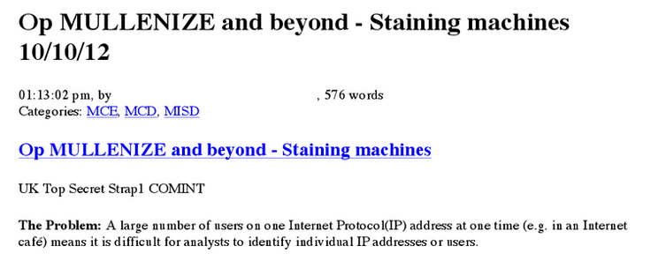
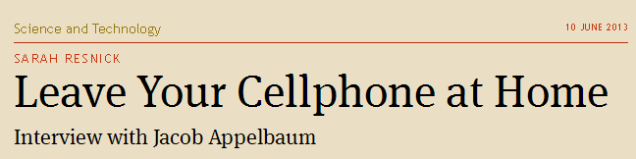
The Leaky Boat

Slide 4
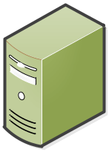


Application Level Attacks
Alice in Repressistan
Unsecured Channel:
“Here’s my IP”
Bob’s
Booby-trap
Alice’s Laptop
Blog
Tor-based Secure Channel
Alice
Freetopia
Repressistan
Javascript Exploit

Slide 5


Correlation Attacks
Bob of Freetopia
Internet
Bob’s Laptop
Bob

Slide 6



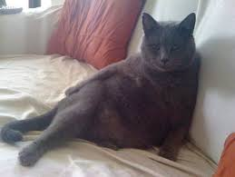
Confiscation Attacks
Carol the Landofopportunian
Carol
Border patrol

Slide 7
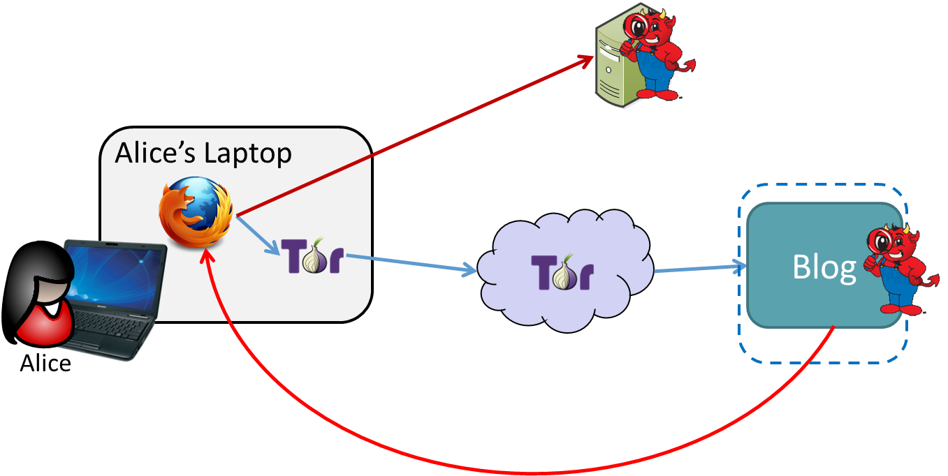
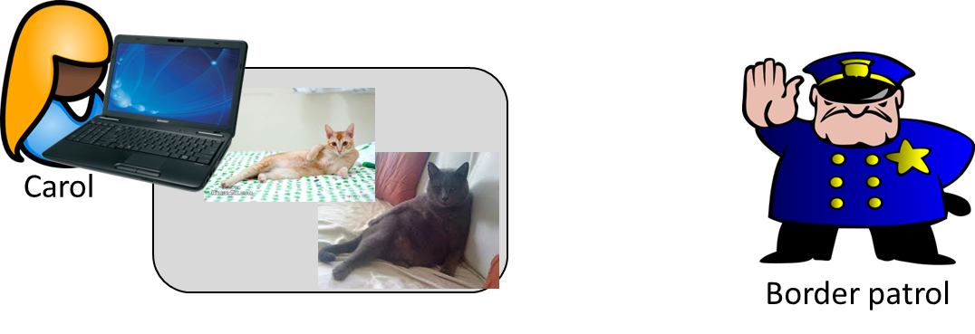
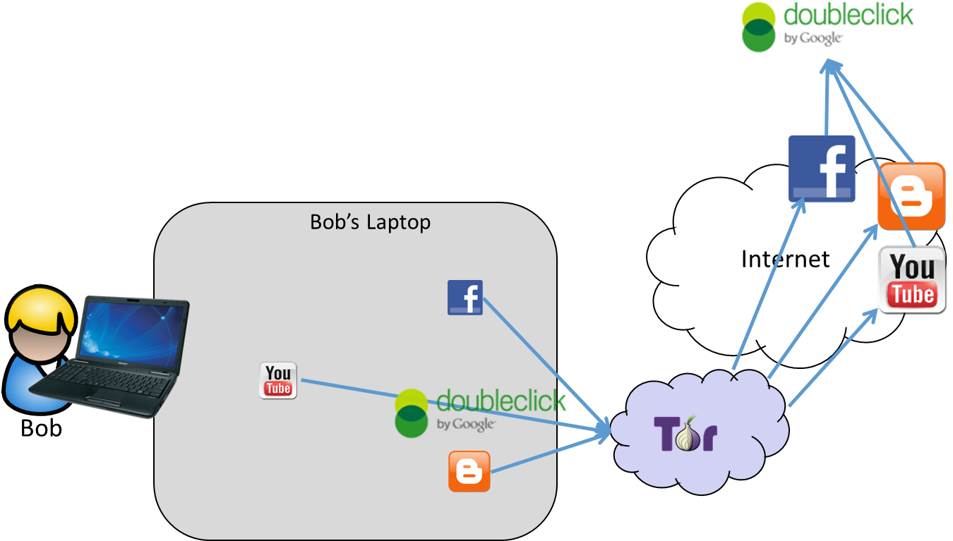
Attack Recap

Slide 8

Nymix – One Layer Deeper
Cloud Storage
Internet
Alice’s Laptop
Nym Manager
Alice
AnonVM
CommVM

Slide 9
Attacks Executed in Nymix

Slide 10
Application Level Attacks
Alice in Repressistan
Unsecured Channel:
“Here’s my IP”
Bob’s
Booby-trap
Alice’s Laptop
Blog
Tor-based Secure Channel
Alice
Freetopia
Repressistan
Javascript Exploit

Slide 11
Application Level Attacks
Alice in Repressistan
Bob’s
Booby-trap
Alice’s Laptop
Blog
Tor-based Secure Channel
Alice
Freetopia
Repressistan
Javascript Exploit

Slide 12

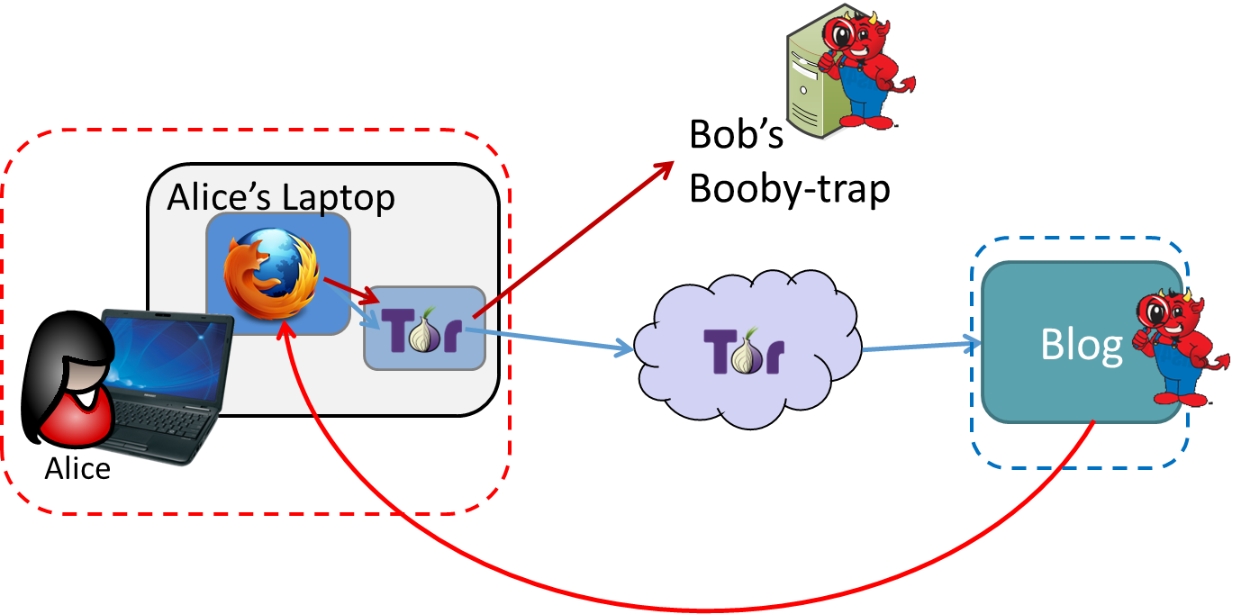
Attacks Executed in Nymix

Slide 13
Correlation Attacks
Bob of Freetopia
Internet
Bob’s Laptop
Bob

Slide 14
Correlation Attacks
Bob of Freetopia
Internet
Bob’s Laptop
Alice’s Laptop
Bob

Slide 15
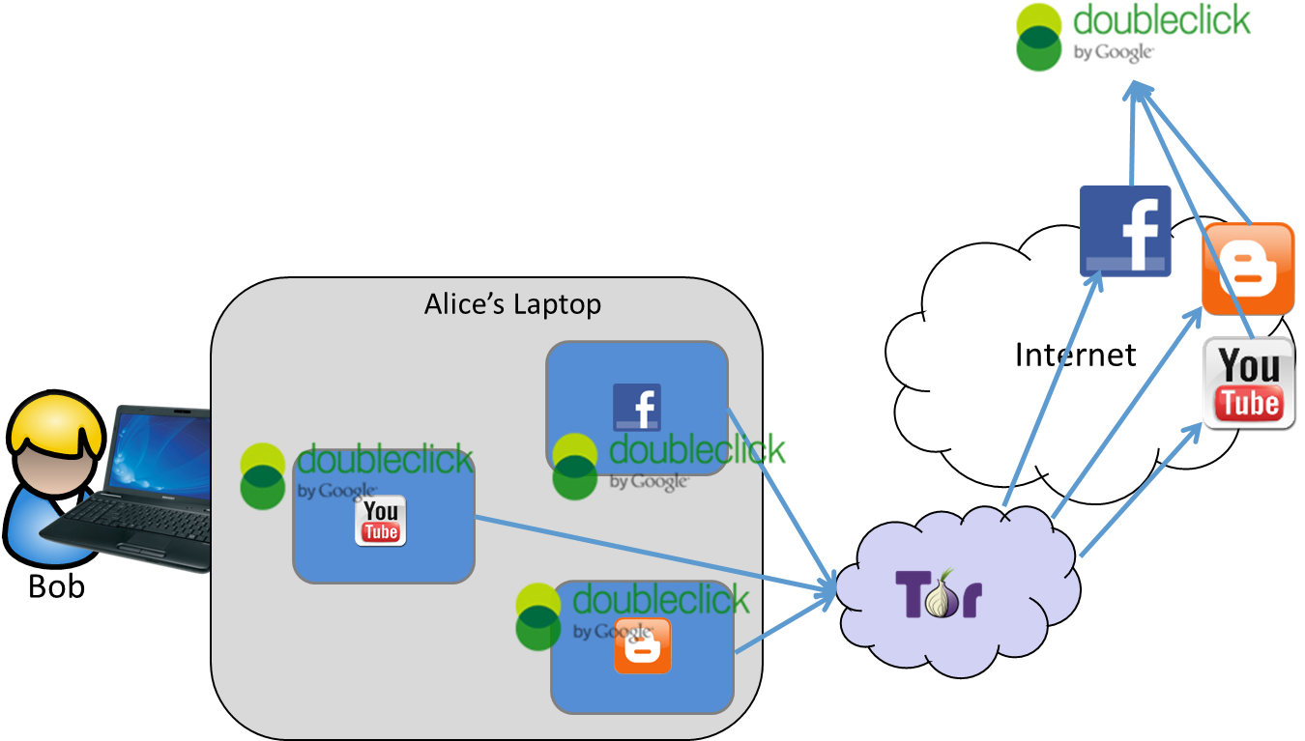
Attacks Executed in Nymix

Slide 16
Confiscation Attacks
Carol the Landofopportunian
Carol
Border patrol

Slide 17
Confiscation Attacks
Carol the Landofopportunian
Carol

Slide 18
Confiscation Attacks
Carol the Landofopportunian
X
Border patrol
Carol

Slide 19
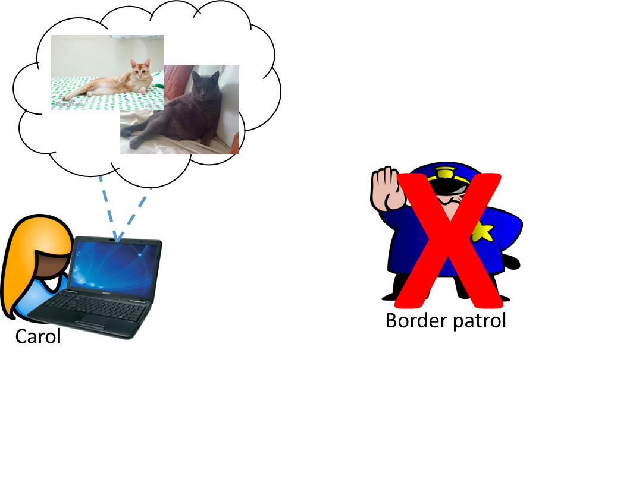
Attacks Executed in Nymix

Slide 20
Evaluation
I7 – 4 cores at 2.7 GHz
8 GB Ram
Connects to a test deployment of Tor
  10 Mbit bandwidth
  200 ms latency
  3 relays
Nym memory usage
  AnonVM – 384 MB RAM, 128 MB Disk (stored in RAM)
  CommVM – 128 MB RAM, 16 MB Disk (stored in RAM)

Slide 21
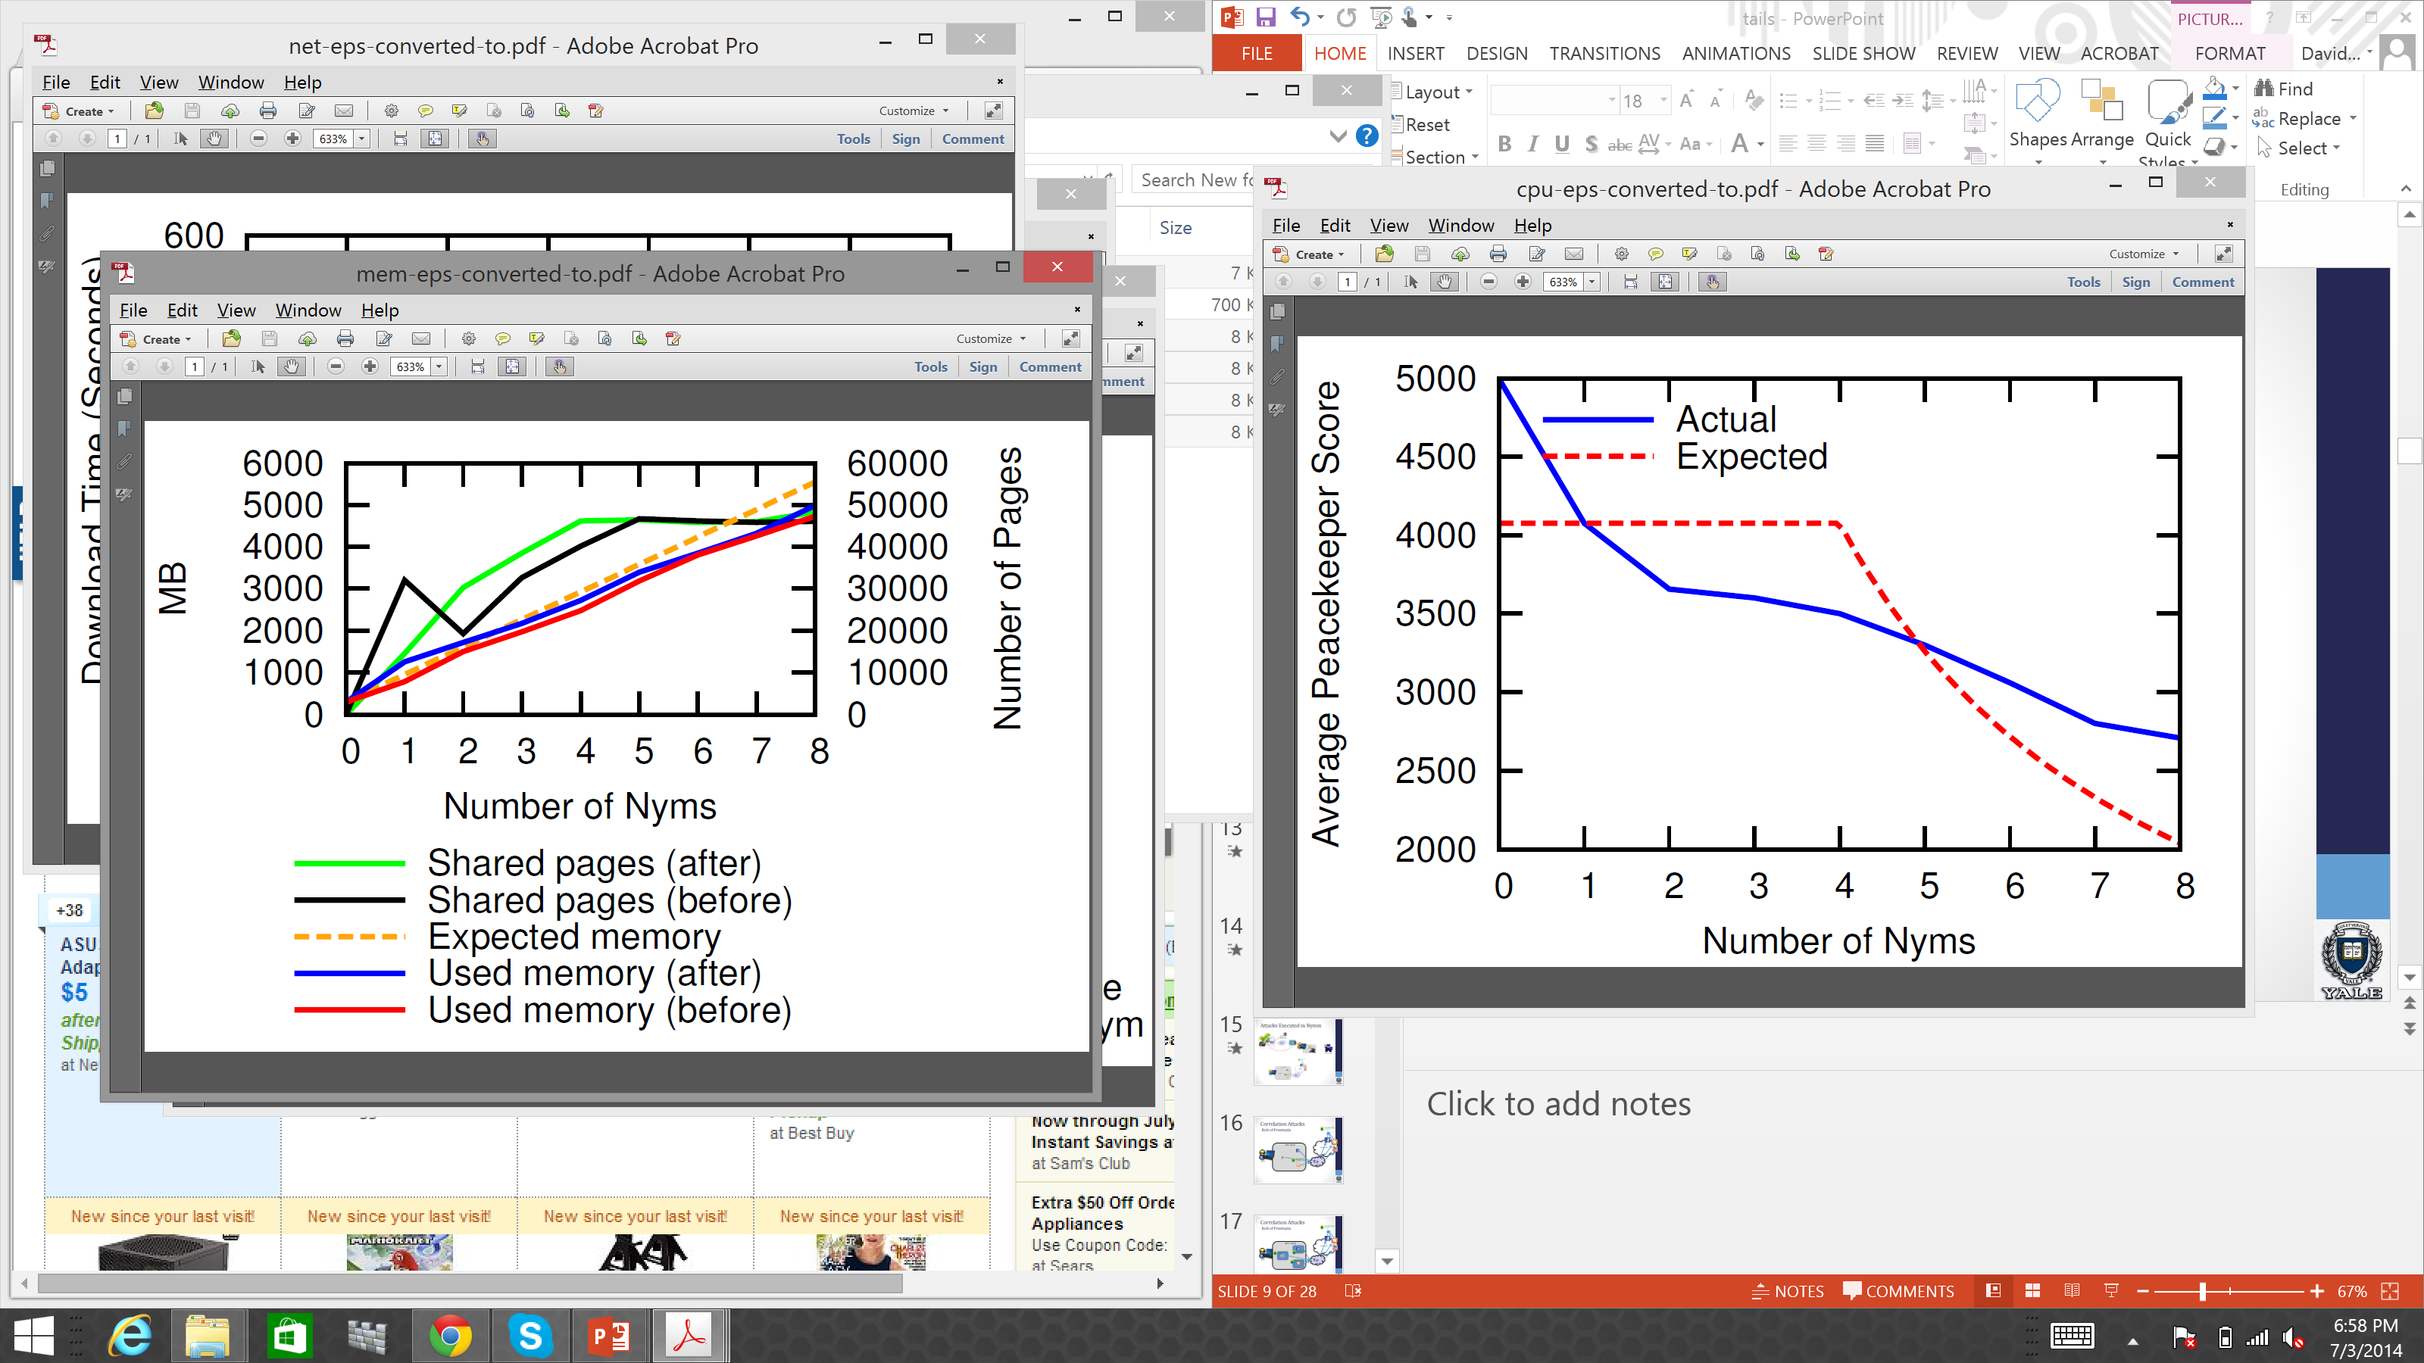
CPU Evaluations

Slide 22
Memory Usage

Slide 23
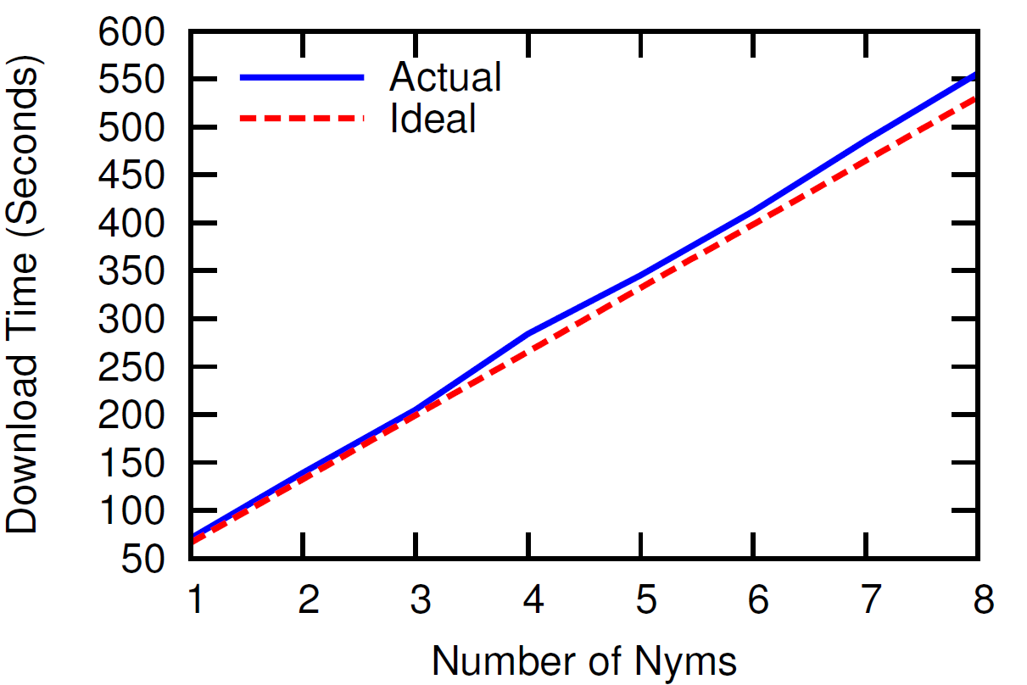
Network Overhead

Slide 24
Nymix is not… It is…
Not a complete solution
An exploration of pseudonymity potential with virtualization
A ready to use system
A research prototype looking at potential integration with tails

Slide 25
Implementation
Ubuntu 14.04
Qemu (KVM) for virtualization
OverlayFS for union file system
Google Chromium (required in order to support a circumvention software)

Slide 26
Integration with Tails
To CommVM or not CommVM
  Each VM is not cheap
  Must share a common Tor guard
Sharing a common base image with Tails
  Tails is well hardened
  Tails has many configurations undesirable for AnonVM
Persistence Models
  Store all data in the cloud
  Encrypted (LUKS) volume, store header elsewhere

Slide 27
Futher Challenges
Resolution of VMM
Fingerprintable CPU
VMM timing channels
Accessing local hardware / data

Slide 28
Going Forward
Tomorrow – 15:00 – 16:00 – Follow up discussion
Slides available
  PDF http://goo.gl/XUVZmC
  PPTX http://goo.gl/0pkHM5
Text available http://arxiv.org/abs/1312.3665
Github https://github.com/DeDiS/WiNoN

