Slide 1
Reducing Latency in Tor Circuits with Unordered Delivery
Michael F. Nowlan, David Wolinsky, and Bryan Ford
Yale University
Dedis Lab

Slide 2



Tor – The Onion Router
Server₀₀
Server₀₁
Server₀₂
Server₁₀
Server₁₁
Server₁₂
Bob
Server₂₀
Server₂₁
Server₂₂
Anonymizing Relays
Notes:
Each host only knows the immediate ingress and egress
Server₀₁ knows Server₁₀ and Server₂₂ but doesn’t know about Bob or Facebook

Slide 3




Tor – The Onion Router
Server₀₀
Server₀₁
Server₀₂
Alice
Server₁₀
Server₁₁
Server₁₂
Bob
Server₂₀
Server₂₁
Server₂₂
Carol
Anonymizing Relays

Slide 4
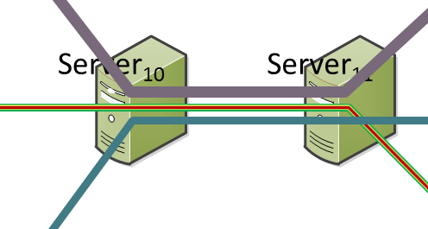
Performance Problems
Traffic between two relays streams across 1 TCP Conn
TCP
TLS
Tor
Data
Carol
Bob
Alice

Slide 5
Performance Problems
Traffic between two relays streams across 1 TCP Conn
Cross circuit Head-of-line blocking
Incoming queue head
Carol
Bob
Alice
Missing Segment
Inaccessible data

Slide 6
Performance Problems
Traffic between two relays streams across 1 TCP Conn
Cross circuit Head-of-line blocking
TCP Buffers can create delays
Outgoing
queue head
Bob
x
Carol
Bob
Alice
Carol
Alice

Slide 7
Outline
Introduction to Tor
Tor / TCP Bottlenecks
Design Space
Tool #1: uTCP
Tool #2: uTLS
Eliminating Head-of-Line Blocking in Tor
Conclusions

Slide 8
Our Goals
Improve Tor QoS for low latency, low bandwidth
  Eliminate head-of-line blocking
  Improve latency for low latency, low bandwidth Apps
Use existing transport (TCP/TLS)
Minimal modifications to Tor
Interoperability with existing Tor deployments

Slide 9
Design Space
Different transports
  DTLS/TCP over UDP, PCTCP, UDP
  Tradeoff between user-space networking stack or add reliability layer
  IPSec not universally configurable
One connection per-circuit
  OS limitations
  Potential performance hit
  No shared congestion state
One connection per-priority
  Torchestra
  May leak information about the flows
  Doubles active sockets, no shared congestion state

Slide 10
Outline
Introduction to Tor
Tor / TCP Bottlenecks
Design Space
Tool #1: uTCP
Tool #2: uTLS
Eliminating Head-of-Line Blocking in Tor
Conclusions

Slide 11
Unordered TCP (uTCP)
Small kernel modification and module
  Less than 600 lines of code
  Supported on Linux Kernel 2.6 and 3
  Recent IETF activity by Apple
Out-of-order reads
Priority sending
Disable congestion control

Slide 12
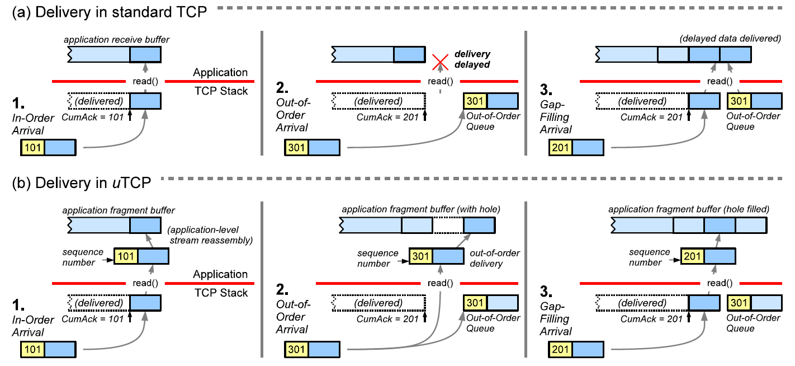
uTCP Out-of-Order Reads

Slide 13
uTCP Priority Sending
Give low latency, low bandwidth circuits preference
Initiate by a setsockopt
User prepends priority to each packet
Inserted into send buffer ahead of lower priority data
Optional squash to erase data from the buffer
Outgoing
queue head
1
Bob
0
Carol
0
Bob
0
Alice
1
Carol
1
Alice
2
Alice
3
Carol

Slide 14
uTCP Disable Congestion Control
Initiated with a setsockopt
Null TCP congestion control kernel module
Always sets congestion window to maximum size

Slide 15
uTCP
Out-of-order reads
Priority sending
Disable congestion control
Remaining issues:
  Tor uses TLS!
  Need a framing mechanism for out-of-order msgs!
    TLS provides framing…

Slide 16
Outline
Introduction to Tor
Tor / TCP Bottlenecks
Design Space
Tool #1: uTCP
Tool #2: uTLS
Eliminating Head-of-Line Blocking in Tor
Conclusions

Slide 17
Processing TLS
Header
  Application data – 0x17
  TLSv1.2 – 0x0303
  Length – Up to 16 KB
Data length check
MAC check
Decryption
Deliver
Type
Version
Length
Record
Data
MAC
Record number

Slide 18
uTLS
Identifying records
  Search for header:
  Verify sufficient bytes for size
Perform a MAC check – Must guess record number
  Try a sequence
  Rollback state when processing out of order
  Fail otherwise
Requires explicit IV an then decrypt and deliver
Type
Version
Size
0x17
0x0303
<= 2^16
Carol
Bob
Alice
Carol
Bob
Alice

Slide 19
Outline
Introduction to Tor
Tor / TCP Bottlenecks
Design Space
Tool #1: uTCP
Tool #2: uTLS
Eliminating Head-of-Line Blocking in Tor
Conclusions

Slide 20
From Tor to Unordered Tor
Apply uTCP and uTLS to Tor to make it support unordered delivery – uTor
Tor has multiple circuits sharing a single TCP stream
  Each circuit passes datagrams or cells
  Each circuit has independent state

Slide 21
uTor – Cell Processing
Record
One cell per record
Each cell specifies its circuit
Can we process cells out of order?
  Assume no, for now
Process cells in order
  Add sequence number to cells
  Header size goes from 5 to 7 bytes
  Payload remains the same
Payload
CircuitID
Version
Payload
 | Tor | uTor | Delta
LoC | 81418 | 81513 | +95 (0.0001%)

Slide 22
Deployment Challenges
uTCP / uTLS adoption
  Not found in main stream kernels
  Currently only truly beneficial for ORs
  Virtualization?
uTor adoption
  uTor must negotiate to use 2 byte cell ID
  Compatible with existing Tor deployments

Slide 23


Preliminary Evaluation of uTor
Tor configuration
  3 Relays
  3 Directory Authorities
  A single proxy
  OP takes the same path through the 3 relays
  Version 0.2.5.0-alpha-dev (git-7c670895b02ba731)
Normally distributed, 50 ms latency
0 and 5% loss
Experiment
  Requests to 40 popular sites on the Internet
  Data sizes 10 KB to 400 KB
Lossy-link

Slide 24
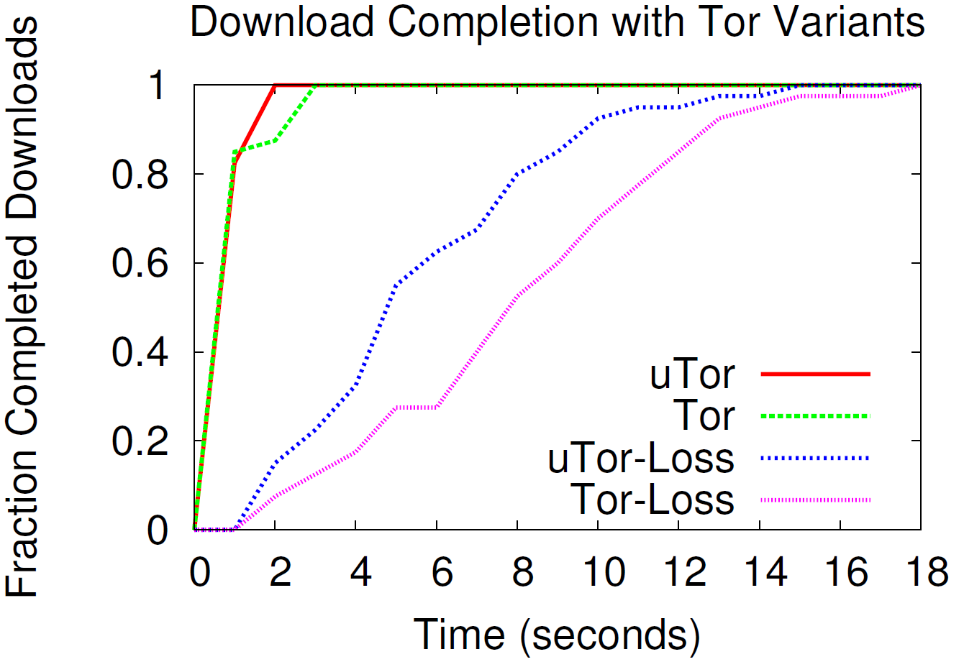
Preliminary Evaluation

Slide 25
Outline
Introduction to Tor
Tor / TCP Bottlenecks
Design Space
Tool #1: uTCP
Tool #2: uTLS
Eliminating Head-of-Line Blocking in Tor
Conclusions

Slide 26
Future Work
uTor shows promise
  Removes head-of-line blocking
  No userspace networking libraries (DTLS/TCP Tor)
  No need to change Tor to use UDP
We can do more
  Investigate improved congestion control algorithms
  Priority sending – Similar to Torchestra
  Impact of head-of-line blocking on congestion control
Out of order circuits interesting but dangerous
  Processing a destroy before receiving all packets
  Assumed in order nature

Slide 27
Thank you for your attention
http://dedis.cs.yale.edu/2009/tng/

Slide 28
The Challenges with TCP
Overlays multiplex a single TCP link for multiple streams
A missed packet in one stream causes delays in all streams
  Logically the streams are not blocked
  TCP blocks until all packets are received in order
Unable to perform priority sending
  Cannot insert into TCP buffer
Layered congestion control
  TOR runs TCP between end points as well as hop by hop
  Receiving a dropped packet in the hop by hop could result in a burst between the end points causing undesirable ramping up

