Slide 1
Dissent in Numbers: Making Strong Anonymity Scale
David Wolinsky¹, Henry Corrigan-Gibbs¹, Bryan Ford¹, and Aaron Johnson²
¹Yale University, ²US Naval Research Laboratory

Slide 2


Motivation – Strength in Numbers
Meet tonight at 7 PM in the park for pizza and beer!
Bob, you’re going be spending some time in the slammer!

Slide 3


Motivation – Strength in Numbers
Meet tonight at 7 PM in the park for pizza and beer!
All of you going to be spending time in the slammer!!!

Slide 4
Motivation – Strength in Numbers

Slide 5
Motivation – Strength in Numbers
Meet tonight at 7 PM in the park for pizza and beer!
Ugh, we can’t put them all in Jail…
This party is over go home!!!

Slide 6
Making Strong Anonymity Scale?
Challenge – tradeoff between scale and strength in anonymity systems favoring scale
Goals
  Strong anonymity (timing analysis resistant)
  Scalability (100s to 1,000s of active participants)
  Churn tolerant (unannounced member departures)
  Accountability
Achieved in Dissent!

Slide 7
Organization
Motivation
Existing Approaches
Dissent – Strong, Scalable Anonymity
  Computational efficiency
  Communication efficiency
  Churn tolerant
  Anonymity
  Accountability
Evaluation
Conclusions

Slide 8
Organization
Motivation
Existing Approaches
Dissent – Strong, Scalable Anonymity
  Computational efficiency
  Communication efficiency
  Churn tolerant
  Anonymity
  Accountability
Evaluation
Conclusions

Slide 9
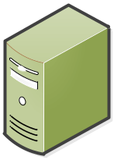


Tor – The Onion Router
Tor is scalable, supports more than 400,000 clients with 1,000 clients per server
Server₀₀
Server₀₁
Server₀₂
Not timing analysis resistant!
time
Server₁₀
Server₁₁
Server₁₂
Meet tonight at 7 PM in the park for pizza and beer!
Bob
Aha! Got you!
Public
Server
Server₂₀
Server₂₁
Server₂₂
Anonymizing Relays
time
State-run ISP

Slide 10


DC-net
Cleartext message
Traffic analysis resistant since all member transmit equal length messages
1
1
1
0
1
Alice
Bob
1
0
0
0
Carol

Slide 11
Practical Considerations
 | Mix-nets | Tor | DC-nets
Strong anonymity | √ |  | √
Scalability |  | √ | √¹
Churn tolerant | √ | √
Accountability |  |  | √²
Mix-nets / Shuffles – Chaum, Neff, Wikstrom
Onion Routing – Tor and I2P
DC-nets – ¹Herbivore and ²Dissent v1
  Herbivore supported many concurrent users but distributed amongst many parallel DC-nets thus lacks the “Strength in Numbers” or large anonymity set sizes

Slide 12
Organization
Motivation
Existing Approaches
Dissent – Strong, Scalable Anonymity
  Computational efficiency
  Communication efficiency
  Churn tolerant
  Anonymity
  Accountability
Evaluation
Conclusions

Slide 13
Key Insight
Crystal
Brett
Server₁
Ben
Anna
Server₀
Server₂
Bob
Alice
Amy
Carol
Notes:
If one peer leaves, message needs to be recomputed

Slide 14
Key Insight
Use DC-net style anonymity within the Mix-net topology to obtain scalability!
Server₁
Server₂
Server₀
Barry
Anna
Ben
Alice
Christine
Carol
Alex
Crystal
Bob
Amy
Brett
Notes:
Reduced computation, more flexibility on missing ciphertexts

Slide 15
Making Strong Anonymity Scale!
Challenge – tradeoff between scale and strength in anonymity systems favoring scale
Dissent’s solution
  Improving Computation Efficiency
  Improving Communication Efficiency
  Handling Churn
  Identifying Disruptions
  Maintaining Strong Anonymity

Slide 16
Improving Computational Efficiency

Slide 17
Computational Overhead
Computation overhead due to O(N²) secret shares
Crystal
Brett
Crystal
Ben
Anna
Bob
Carol
Amy
Alice
Anna
Ben
Bob
Alice
Amy
Carol
Notes:
If one peer leaves, message needs to be recomputed

Slide 18

Computational Overhead
N = 100,
4950 shared secrets,
9900 RNG operations
5.5 ms/peer
Computation overhead due to O(N²) secret shares
Crystal
Brett
Crystal
Ben
Anna
Bob
Server₁
Carol
Amy
Alice
Anna
Cleartext
Ben
Server₀
Ciphertext
Server₂
Bob
Alice
Amy
Carol
Notes:
If one peer leaves, message needs to be recomputed

Slide 19
Computational Improvement
With M servers and N clients…
Server₁
O(M*N) shared secrets with M << N
Server₂
Each server has N secrets
Server₀
RNG reduction:
1000 << 9900
Anna
Ben
Alice
Christine
Carol
Alex
Crystal
Bob
Amy
Brett
N = 100 and M = 5,
500 shared secrets,
1000 RNG operations
Each client has M secrets
Notes:
Reduced computation, more flexibility on missing ciphertexts

Slide 20
Improving Communication Efficiency

Slide 21
Bandwidth Overhead
N = 100,
Ciphertexts exchanged in
DC-nets: 9900
Computation overhead due to O(N²) secret shares
Crystal
Brett
Bandwidth overhead due to O(N²) communication
Ben
Anna
Crystal
Ben
Anna
Bob
Brett
Carol
Amy
Alice
Bob
Cleartext
Alice
Amy
Carol
Notes:
If one peer leaves, message needs to be recomputed

Slide 22
Bandwidth Efficiency
Brett
Earlier DC-nets had O(N²) communication cost
Alex
Bob
Crystal
Christine
Barry
Amy
Server₁
Anna
Ben
Server₁
Server₂
Carol
Alice
Server₁
Server₂
Server₂
We can construct a DC-net aware multicast tree!
Server₀
Server₀
Server₀
Barry
Anna
Ben
Alice
Christine
Carol
Alex
Crystal
Bob
Amy
Brett
Clients submit their ciphertext upstream to one server
Notes:
Reduced computation, more flexibility on missing ciphertexts

Slide 23
Bandwidth Efficiency
Earlier DC-nets had O(N²) communication cost
Server₁
Server₀
Server₀
Server₀
Server₁
Server₁
Server₁
Server₂
Server₂
Server₂
We can construct a DC-net aware multicast tree!
Server₂
Server₀
Cleartext
Cleartext
Cleartext
N = 100 and M = 5
Ciphertexts exchanged in
DC-nets: 9900, Dissent: 205
Barry
Anna
Ben
Alice
Christine
Carol
Alex
Crystal
Bob
Amy
Brett
Clients submit their ciphertext upstream to one server
Servers XOR these messages together and share with each other
Servers XOR these messages to compute the cleartext and distribute it to their downstream clients
Notes:
Reduced computation, more flexibility on missing ciphertexts

Slide 24
Creating Churn Tolerance

Slide 25
Churn Intolerance
The resulting cleartext is garbage due to the dependency on Alice’s secret shares
Computation overhead due to O(N²) secret shares
Crystal
Brett
Bandwidth overhead due to O(N²) communication
What if Alice left without transferring?
Ben
Anna
Crystal
Ben
Anna
Bob
Brett
Carol
Amy
Alice
Bob
Garbage
Alice
Amy
Carol
Notes:
If one peer leaves, message needs to be recomputed

Slide 26
Tolerating Churn
Server₁ will timeout on Alex
The protocol continues uninterrupted, since the servers have yet to compute their ciphertext
Server₁
Server₂
Server₀
Barry
Anna
Ben
Alice
Christine
Carol
Alex
Crystal
Bob
Amy
Brett
Notes:
Reduced computation, more flexibility on missing ciphertexts

Slide 27
Handling Disruptions via Accountability…

Slide 28

DC-net – Disruptions
Easily disrupted
x
1
1
1
1
0
1
0
Alice
Bob
1
0
0
0
0
How can we prove Bob transmitted the wrong ciphertext without losing anonymity?
Carol

Slide 29
Scheduling
How do many members share the DC-net without disrupting each other?
Anonymizing shuffle produces random permutation and hence the schedule
Create a transmission schedule!
Alice
Bob
Carol
Key_{Alice}
Key_{Carol}
Shuffle
Key_{Bob}
Key_{Alice}
DC-net
Key_{Carol}
Key_{Bob}
Slot_{Carol}
Slot_{Alice}
Slot_{Bob}

Slide 30
DC-net
Integrity check (parity bit)
x
111
101
111
000
110
Alice
Bob
010
010
110
To determine the disruptor Alice needs to anonymously specify a bit that the disruptor “flipped” from 0 -> 1
100
Integrity check failed!
Carol

Slide 31
Safely Deanonymize a Bit
Alice
Bob
Carol
{Bit₁}_{Alice}
0
Shuffle
0
{Bit₁}_{Alice}
0
0

Slide 32
DC-net
In practice, this is a bit more complicated though the details are in the paper.
101
111
1 with Bob
1 with Carol
1 with Alice
0 with Carol
111
000
110
Alice
Bob
Revealing the shared secret, Alice can confirm that Bob disrupted the previous round
010
110
100
1 with Alice
1 with Bob
Carol

Slide 33
Progress!
We have gained
  Improvements in computation and communication
  Ability to tolerate churn
  Identify disruptors
How does this impact strong anonymity?

Slide 34
DC-net – Anonymity Set
Anonymity set size: 8 (Honest participants)
Anonymity set size: 4 (Honest participants)
Crystal
Brett
Ben
Anna
Bob
Alice
Amy
Carol

Slide 35
Dissent retains this feature…

Slide 36
Dissent – Anonymity Set
Anonymity set size: 11 (Honest participants)
Anonymity set size: 7 (Honest participants)
Server₁
Server₂
Server₀
Barry
Anna
Ben
Alice
Christine
Carol
Alex
Crystal
Bob
Secret sharing graph prevents the clients upstream server from deanonymizing it
Amy
Brett
Anonymity set remains equal as long as there is 1 honest server
Notes:
Reduced computation, more flexibility on missing ciphertexts

Slide 37
Organization
Motivation
Existing Approaches
Dissent – Strong, Scalable Anonymity
  Computational efficiency
  Communication efficiency
  Churn resistance
  Anonymity
  Accountability
Evaluation
Conclusions

Slide 38
Dissent – Prototype
Written in C++
  Qt from networking, serialization, and events processing
  Crypto++ as the crypto library

Slide 39
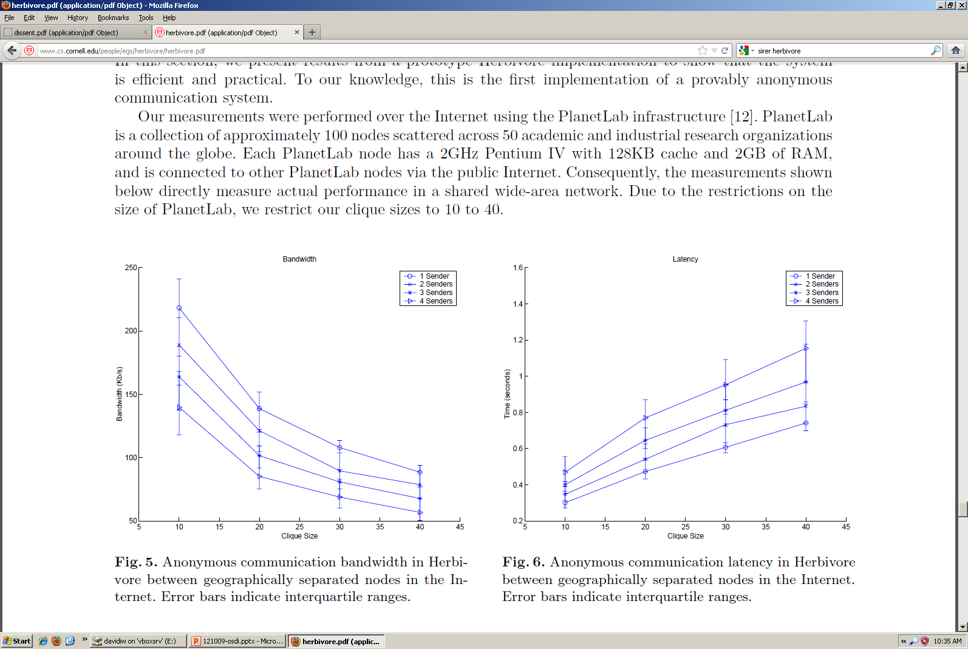
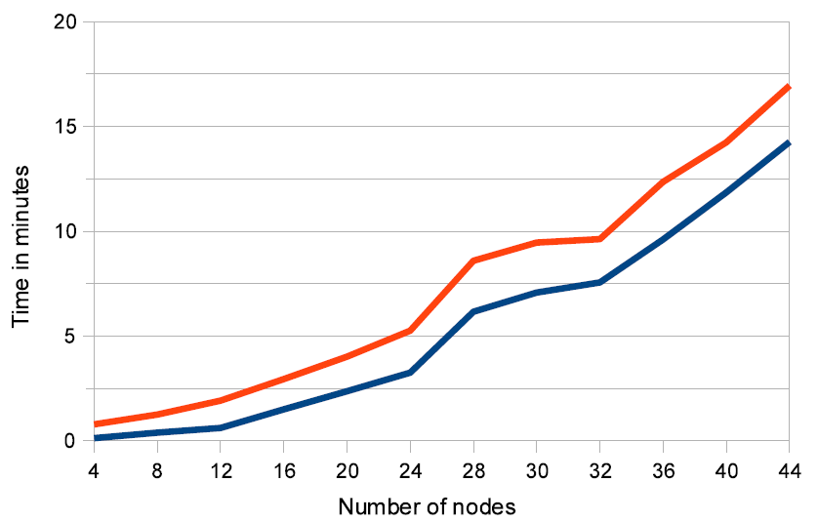
Related Work
Herbivore TR‘03
Evaluated only up to 40 members
Dissent CCS’10

Slide 40
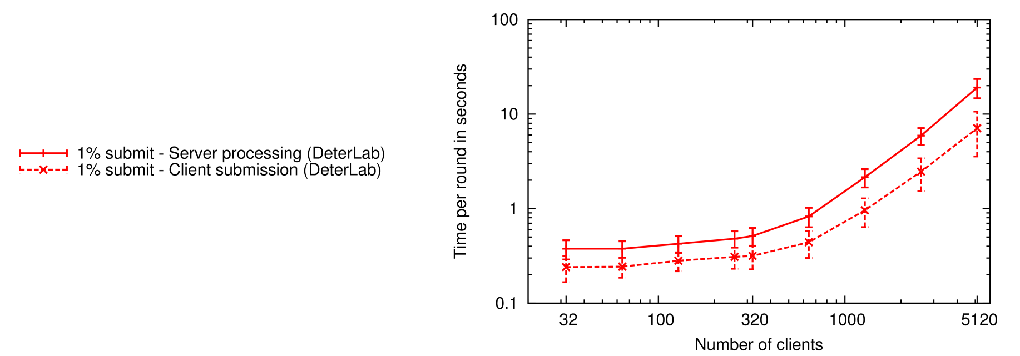
Scaling to Thousands of Clients
CPU Overheads
Bandwidth limitations
Latency limited
1,000 clients
~1 second
> 5,000 concurrent clients!!

Slide 41
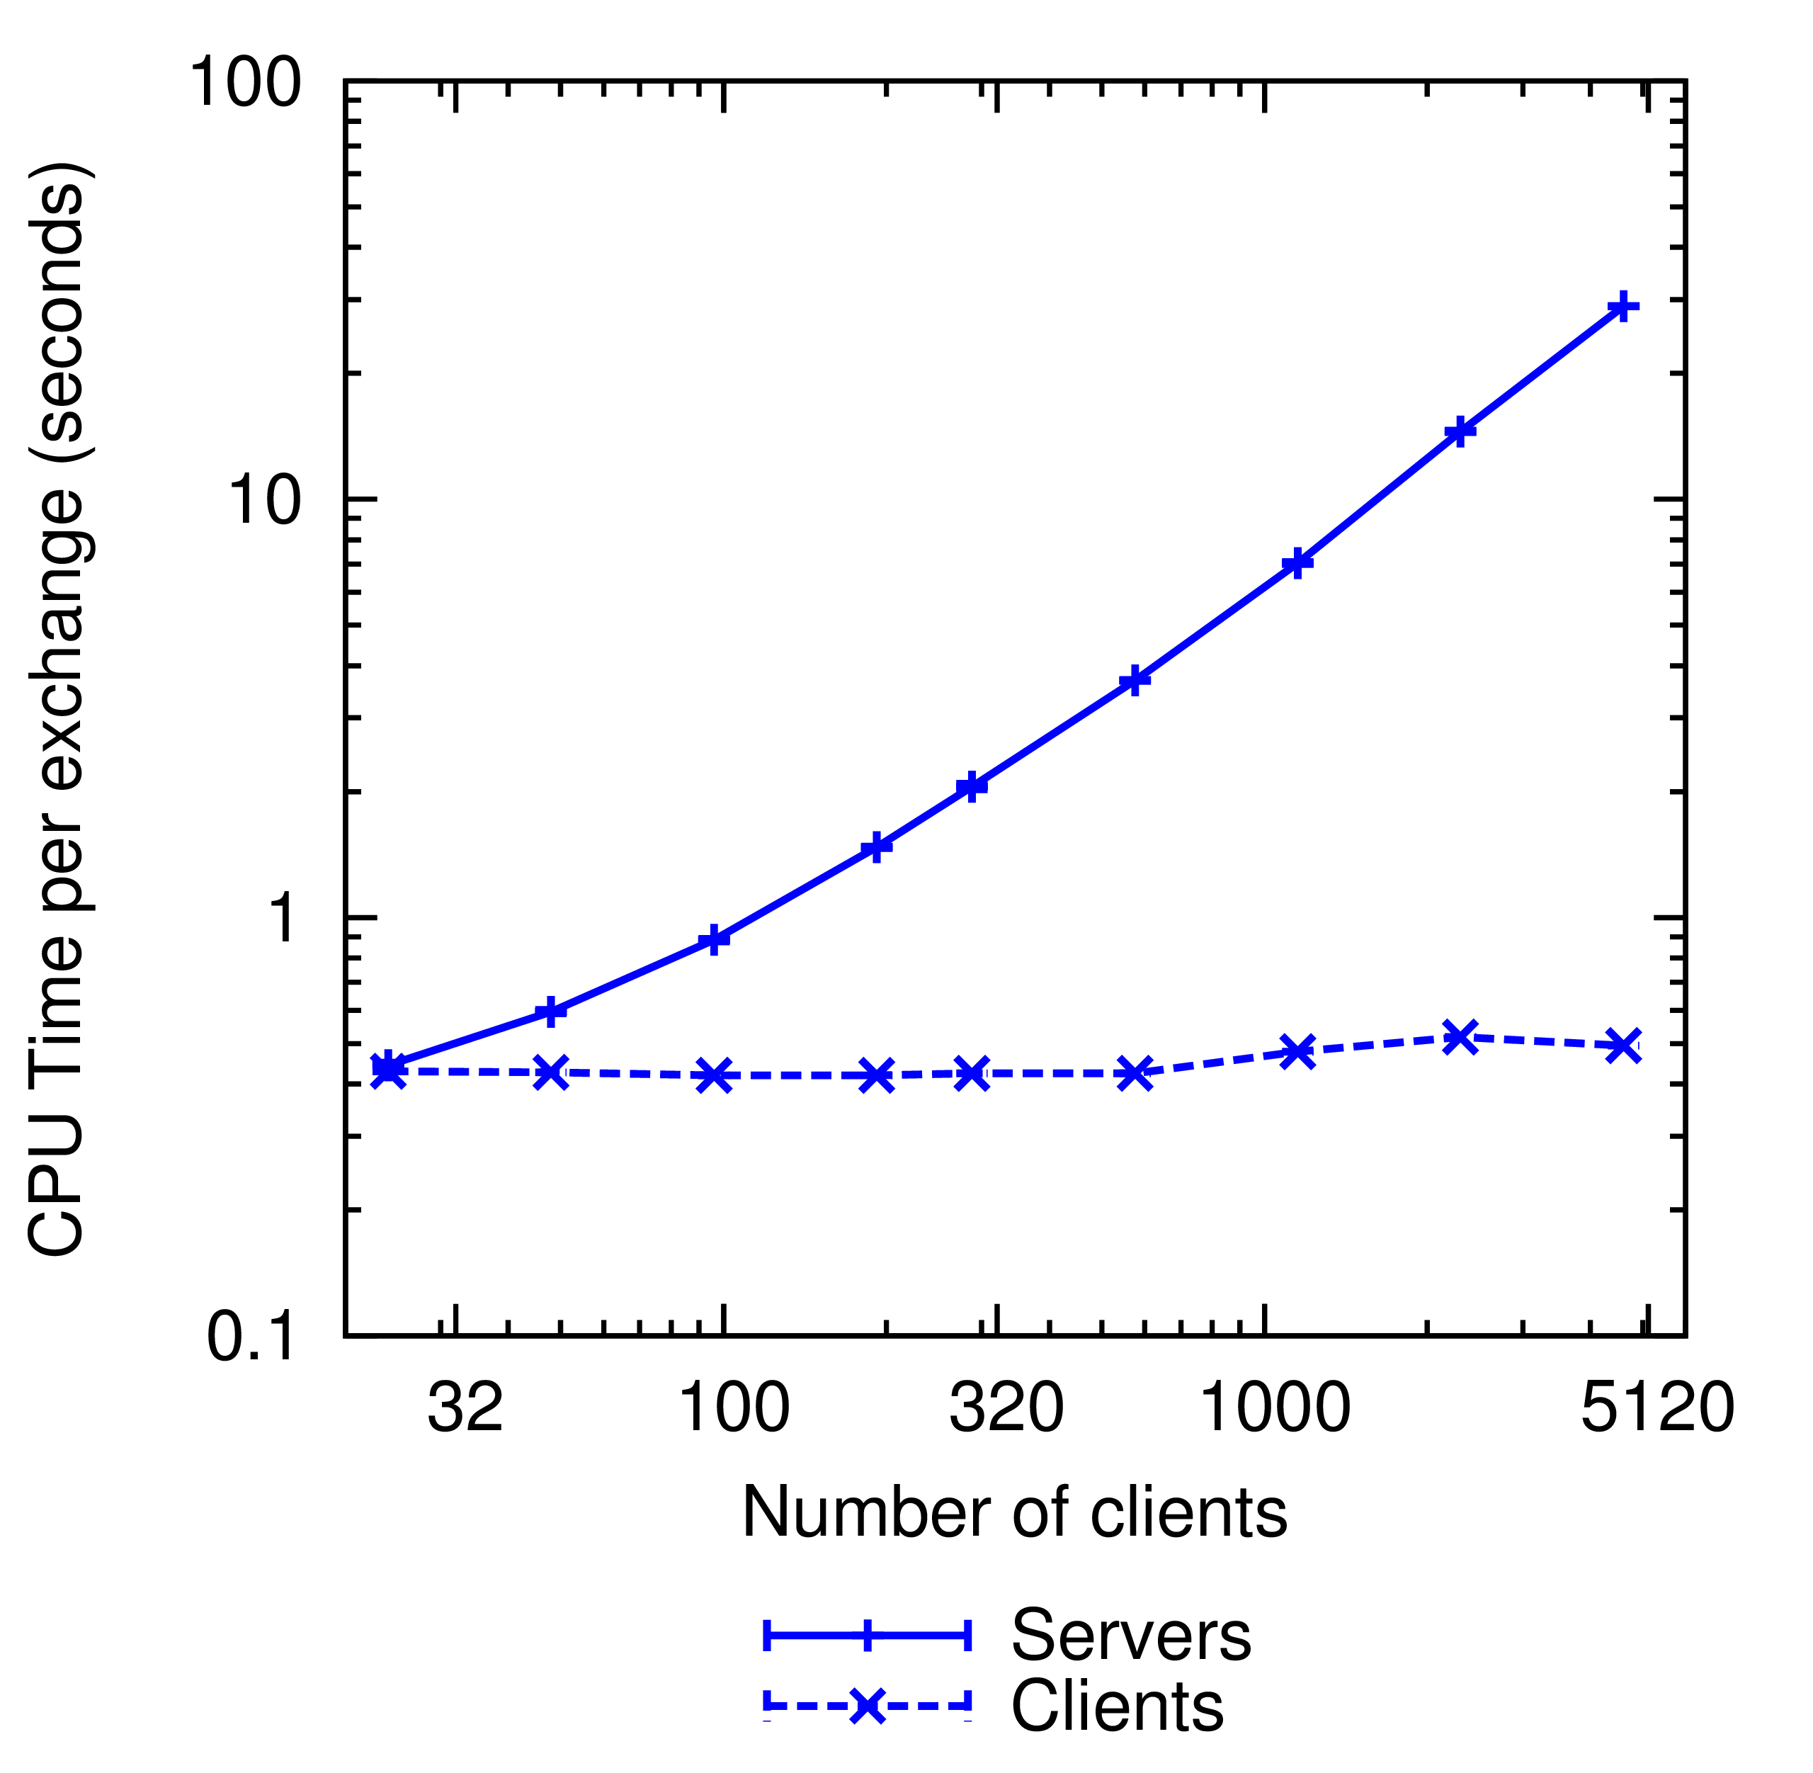
CPU Time
5.5 ms/client

Slide 42
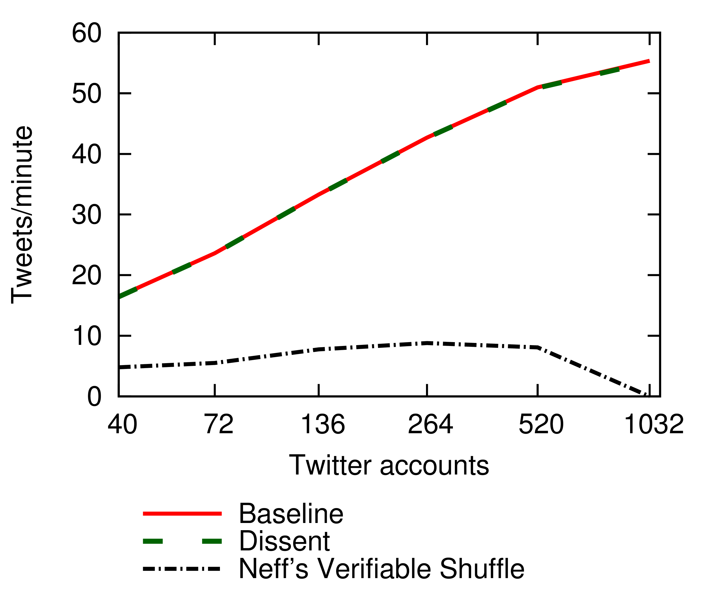
Comparison to Shuffles
Dissent keeps up!
Verifiable shuffles do not

Slide 43
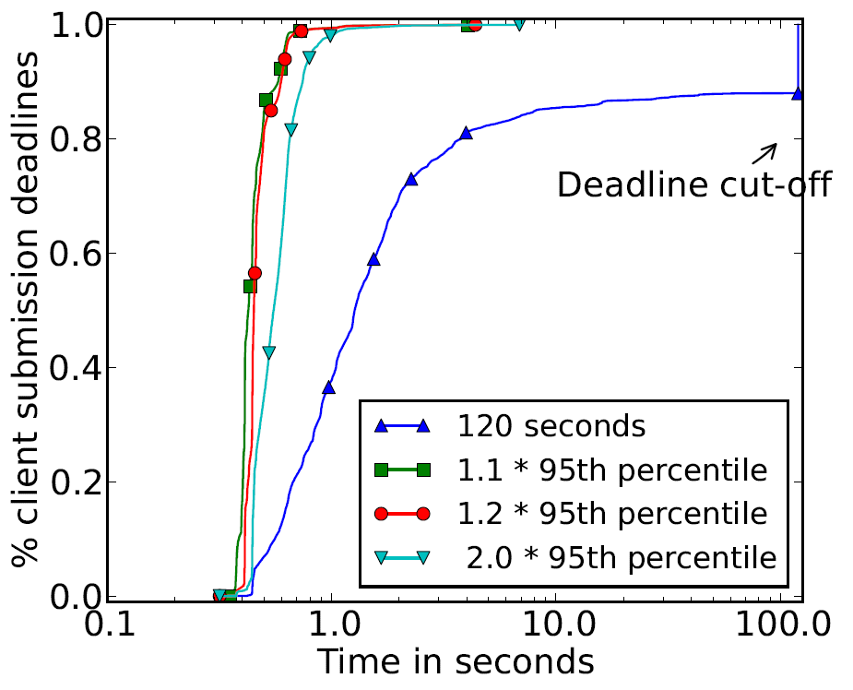
Churn Resilience
Nearly 99% complete in less than 1 second
Nearly 50% complete in less than 400 ms

Slide 44
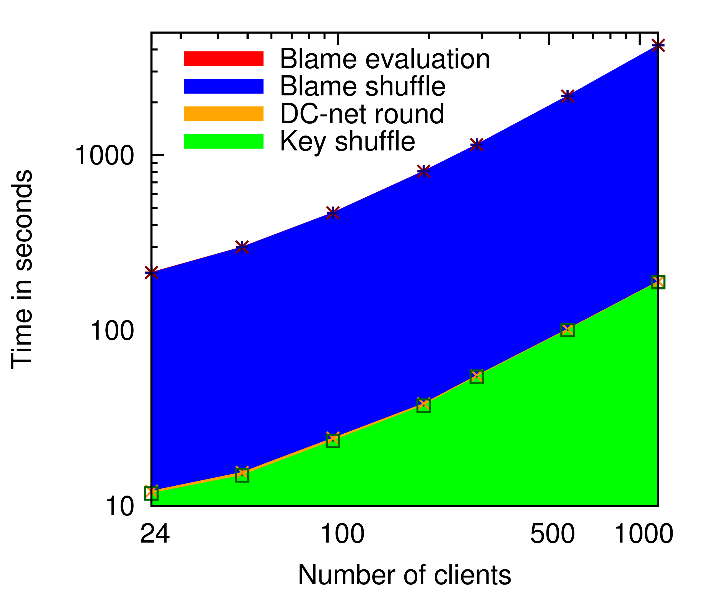
Protocol Breakdown
Really slow blame shuffle
Efficient disruption analysis
“Fast” DC-net
Slow Key Shuffle

Slide 45
Organization
Motivation
Existing Approaches
Dissent – Strong, Scalable Anonymity
  Computational efficiency
  Communication efficiency
  Churn resistance
  Anonymity
  Accountability
Evaluation
Conclusions

Slide 46
Key Take Aways
We can construct strong and scalable anonymous communication systems
  O(N²) communication cost to O(N)
  Churn tolerance
  Provides an effective means to identify disruptors
Two orders of magnitude larger anonymity sets than previous DC-net approaches
Maintains strong anonymity properties from DC-nets

Slide 47
Future Work
Further bandwidth and computation optimizations
Slot length scheduling policies
Better ways to anonymously distribute blame
Handling long term intersection attacks
Formal security analysis
Making available for real applications and real users

Slide 48
Finished!
Thanks, questions?
Dissent – Strong, scalable accountable anonymity
Find out more at http://dedis.cs.yale.edu/2010/anon/
We’ll be at the poster session tonight!

Slide 49
Extra slides

Slide 50
Evaluation Topology
Server₂
100 Mbit/sec LAN
with 10 msec delay
Server₀
Barry
Anna
100 Mbit/sec shared upstream link
with 50 msec delay
Servers might be run within a single cloud but owned by different “anonymity providers”
Server₁
Alice
Christine
Bob
8 – 16 servers
1 – 320 clients per server
24 –5120 clients
Carol
Alex
Crystal
Amy
Notes:
Reduced computation, more flexibility on missing ciphertexts

Slide 51
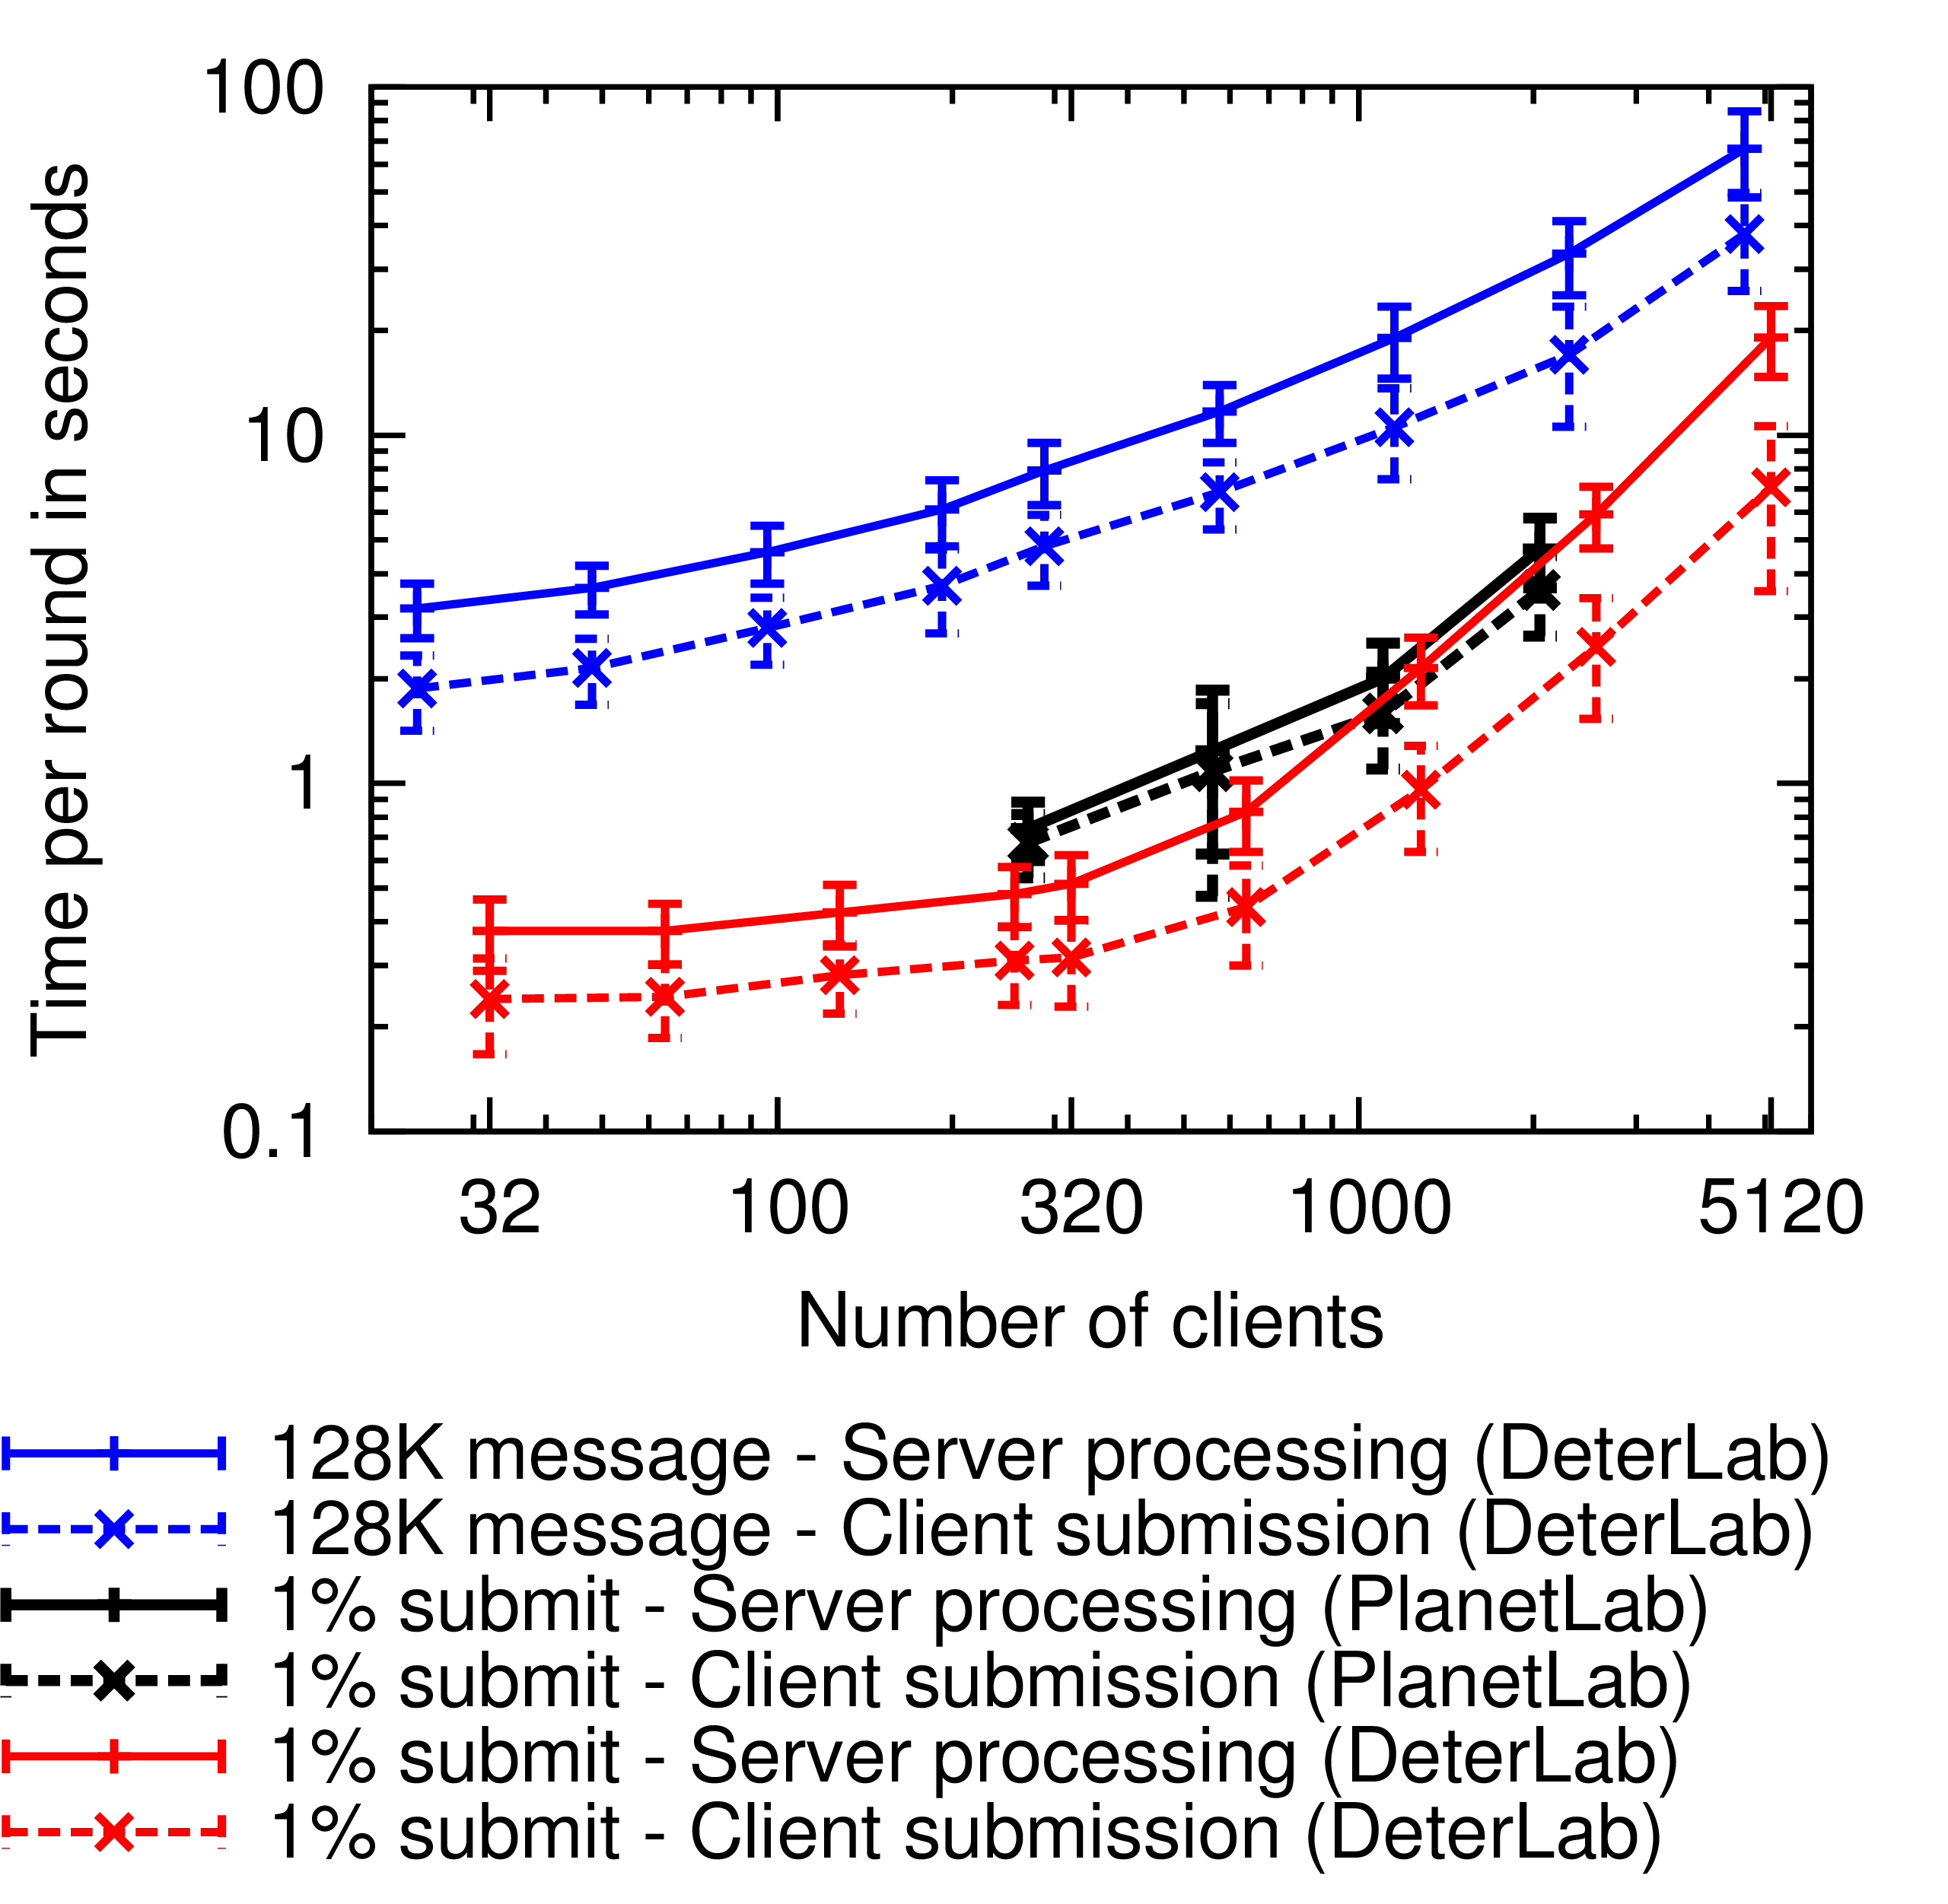
Scaling to Thousands of Clients
CPU Overheads
Bandwidth limitations

Slide 52

Pure Mix-Nets / Shuffles
Wait until sufficient clients have submitted
Data_{Alice}
Data_{Bob}
Each server performs in serial expensive decryption operations
Server₀
Alice
Data_{Bob}
Data_{Carol}
Data_{Alice}
Data_{Alice}
Data_{Carol}
Bob
Data_{Bob}
Data_{Bob}
Data_{Bob}
Server₁
Data_{Alice}
Data_{Carol}
Data_{Carol}
Carol
Data_{Alice}
Data_{Carol}
Server₂
Data_{Bob}
Data_{Alice}
Data_{Alice}
Data_{Carol}
Data_{Bob}
Data_{Carol}

Slide 53
Dissent
Server₁
Servers connect with each other
Clients connect to a single upstream server
Server₀
Server₂
Carol
Bob
Alice
Notes:
Reduced computation, more flexibility on missing ciphertexts

Slide 54
Dissent
Server₁
Diffie-Hellman public keys exchanged during registration
Clients have a shared secret with each server
Server₀
Server₂
Secret_{A0}
Secret_{A1}
Secret_{A2}
Carol
Bob
Alice
Notes:
Reduced computation, more flexibility on missing ciphertexts

Slide 55
Dissent
Server₁
Server₀
Server₂
Secret_{A0}
Secret_{A1}
Secret_{A2}
Cleartext_{A} = blame, nonce, next slot length, msg, hash
Ciphertext_{A0} = RNG(Secret_{A0}, length)
Ciphertext_{A} = Ciphertext_{A0} XOR Ciphertext_{A1} XOR
Ciphertext_{A2} XOR (0, …, 0, Cleartext_{A}, 0, …, 0)
Alice
Notes:
Reduced computation, more flexibility on missing ciphertexts

Slide 56
Dissent
Server₁
Server₀
Server₂
Ciphertext_{A}
Cleartext_{A} = blame, nonce, next slot length, msg, hash
Ciphertext_{A0} = RNG(Secret_{A0}, length)
Ciphertext_{A} = Ciphertext_{A0} XOR Ciphertext_{A1} XOR
Ciphertext_{A2} XOR (0, …, 0, Cleartext_{A}, 0, …, 0)
Alice
Notes:
Reduced computation, more flexibility on missing ciphertexts

Slide 57
Dissent
Server₁
Server₀
Server₂
Ciphertext_{C}
Ciphertext_{B}
Ciphertext_{A}
Carol
Bob
Alice
Notes:
Reduced computation, more flexibility on missing ciphertexts

Slide 58
Dissent
Client list exchange
Server₁
[Carol]
[Alice]
[Alice]
[Carol]
Server₀
Server₂
[Alice]
[Bob]
Notes:
Reduced computation, more flexibility on missing ciphertexts

Slide 59
Dissent
Client list exchange
Server₁
Ciphertext evaluation
Commit₁
Commit₂
Ciphertext commit
Commit₀
Commit₁
Server₀
Server₂
Commit₀
Commit₂
Server₀ knows that Alice, Bob, and Carol submitted:
Ciphertext₀ = Ciphertext_{A} XOR Ciphertext_{A0} XOR
Ciphertext_{B0} XOR Ciphertext_{C0}
Commit₀ = Hash(Ciphertext₀)
Notes:
Reduced computation, more flexibility on missing ciphertexts

Slide 60
Dissent
Client list exchange
Server₁
Ciphertext evaluation
Ciphertext₁
Ciphertext₂
Ciphertext commit
Ciphertext₀
Ciphertext₁
Ciphertext exchange
Server₀
Server₂
Ciphertext₀
Ciphertext₂
Server₀ knows that Alice, Bob, and Carol submitted:
Ciphertext₀ = Ciphertext_{A} XOR Ciphertext_{A0} XOR
Ciphertext_{B0} XOR Ciphertext_{C0}
Commit₀ = Hash(Ciphertext₀)
Notes:
Reduced computation, more flexibility on missing ciphertexts

Slide 61
Dissent
Client list exchange
Server₁
Ciphertext evaluation
Signature₁
Signature₂
Ciphertext commit
Signature₀
Signature₁
Ciphertext exchange
Server₀
Server₂
Signature₀
Signature₂
Cleartext evaluation
Cleartext commit
Server₀ knows that Alice, Bob, and Carol submitted:
Ciphertext₀ = Ciphertext_{A} XOR Ciphertext_{A0} XOR
Ciphertext_{B0} XOR Ciphertext_{C0}
Commit₀ = Hash(Ciphertext₀)
Cleartext = Ciphertext₀ XOR Ciphertext₁ XOR
Ciphertext₂
Signature₀ = {Cleartext}_{Key0}
Notes:
Reduced computation, more flexibility on missing ciphertexts

Slide 62
Dissent
Client list exchange
Server₁
Ciphertext evaluation
Ciphertext commit
Ciphertext exchange
Server₀
Server₂
Cleartext
Cleartext evaluation
Cleartext
Cleartext
Cleartext commit
Cleartext distribution
Carol
Bob
Alice
Notes:
Reduced computation, more flexibility on missing ciphertexts

Slide 63
Dissent – Blame
Server₁
Server₀
Server₂
Cleartext_{A} = blame, nonce, next slot length, msg, hash
Ciphertext_{A0} = RNG(Secret_{A0}, length)
Ciphertext_{A} = Ciphertext_{A0} XOR Ciphertext_{A1} XOR
Ciphertext_{A2} XOR (0, …, 0, Cleartext_{A}, 0, …, 0)
Alice
Notes:
Reduced computation, more flexibility on missing ciphertexts

Slide 64
Identifying Disruptors

Slide 65
Dissent – Blame
Server₁
Server₀
Server₂
Ciphertext_{A}
Cleartext_{A} = blame, nonce, next slot length, msg, hash
Ciphertext_{A0} = RNG(Secret_{A0}, length)
Ciphertext_{A} = Ciphertext_{A0} XOR Ciphertext_{A1} XOR
Ciphertext_{A2} XOR (0, …, 0, Cleartext_{A}, 0, …, 0)
Alice
Notes:
Reduced computation, more flexibility on missing ciphertexts

Slide 66
Dissent
Round will complete as normal, but everyone will see the blame flag set, resulting in a blame shuffle
Server₁
Server₀
In the blame shuffle, the slot owner will specify a bit to deanonymize which will reveal the offending client / server
Server₂
Cleartext
Cleartext
Cleartext
The message in the shuffle is signed with the slot owner’s anonymous meaning it is safe to deanonymize
Carol
Bob
Alice
Notes:
Reduced computation, more flexibility on missing ciphertexts

Slide 67
Related Work – Herbivore
Time between messages
With 40 members, communication delays between .6 and 1.2 seconds

Slide 68
Related Work – Earlier Dissent
Time to transfer 1 MB
With 44 members, communication delays for the DC-net were 2 minutes

Slide 69
Future Work in Dissent
Disruption resistance is online, requires additional steps after the protocol has completed
Practical use in real environments – Such as using WiFi enabled smart phones
Anonymity boxes – isolated environments running within a virtual machine isolating the user’s private information from the anonymity network
Participation limits to prevent Sybil attacks

Slide 70
Dissent Disruption Resistance
A malicious bit flip resulting from a 0 -> 1 in the cleartext can be used to generate an accusation
  In a DC-net, client requests accusation shuffle
  In shuffle, client specifies the flipped bit
Servers share bits for this bit index, finding either
  A server sent bits that do not match his ciphertext – thus he is guilty of the disruption
  A client’s ciphertext does not match the accumulation of the server’s bits
Clients rebut by sharing with servers the shared secret of the offending server, accepting blame, or remaining suspect

Slide 71
Analytical Comparison
Feature | DC-Nets | Herbivore | Dissent
Messages | O(N²) | O(N) | O(N)
Secrets | O(N²) | O(N²) | O(N*M)
Anon | O(K) | O(K) | O(K) , assuming 1 honest server
N = Members (clients)
M = Servers
K = honest members

Slide 72
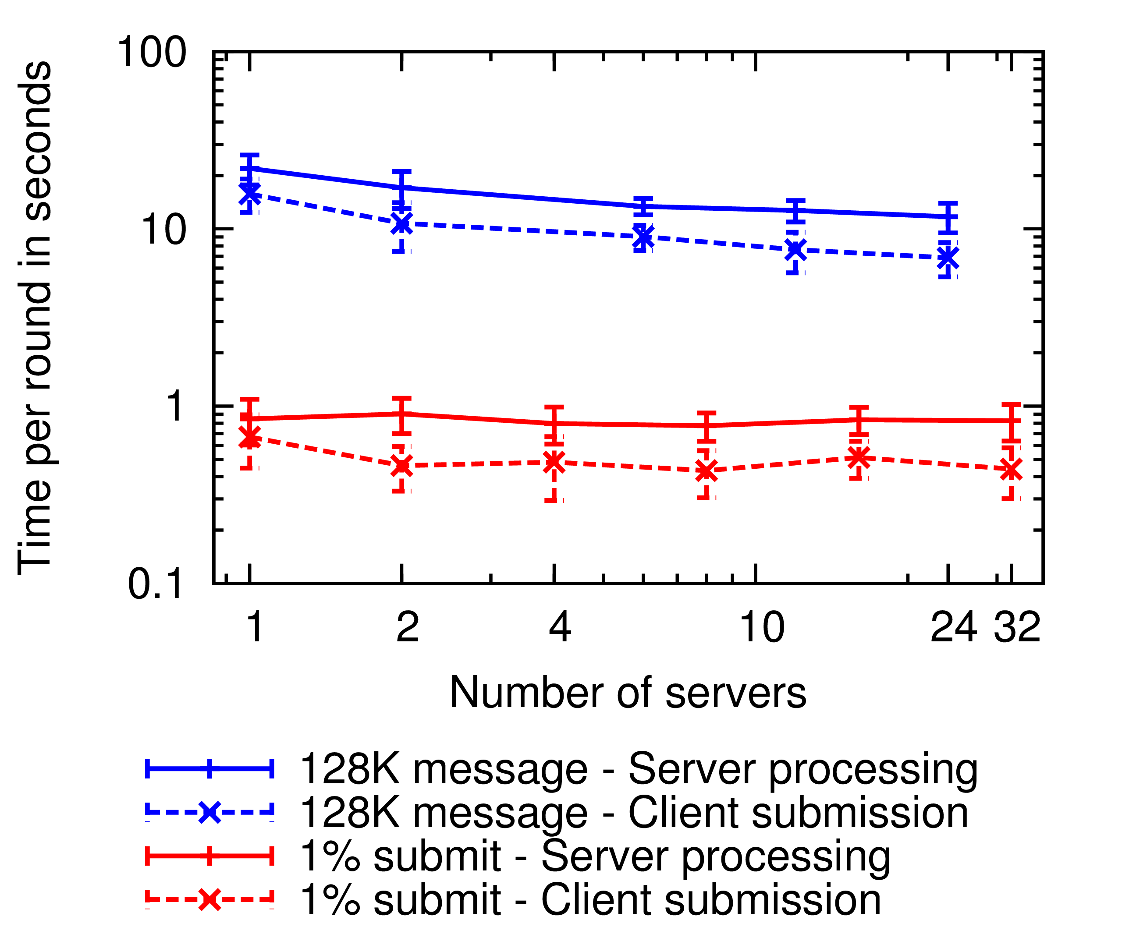
Server Count Effects
6.25 second
9 seconds
5.5 second
220 ms
Notes:
CPU time lost in the synchronous breaks

Slide 73
Analytical Comparison
 | Feature | Dissent | D3
Shuffle | Comm | O(N) serial steps | O(1)
 | Anon | O(K), K = honest members | O(K), K = honest members, assuming 1 honest server
DC-net | Comm | O(N²) messages O(N²) shared secrets | O(N) messages O(N) shared secrets
 | Anon | O(K), K = honest members | O(K), K = honest members, assuming 1 honest server

Slide 74
Client/Server Trust Models
Trust all servers
  Unrealistic in the real world
Trust no servers – SUNDR
  Ideal but complicated due to lack of knowledge and message time constraints
Trust at least one server – Anytrust
  With one honest server, anonymity set is equal to the set of all honest members (clients)
  No need to know which server to trust
  (Used in Mix-nets)

Slide 75
DC-Nets Generalized
Members share secrets with each other
  Such as Diffie-Hellman exchanges
  Can be used to generate variable length string
Each member constructs a ciphertext
  XOR in the string generated by each shared secret
  Optionally, XOR secret message
Positions inside a DC-net can be assigned via randomness (Ethernet style backoff) or a Mix-Net
After obtaining a copy of each ciphertext
  XOR each ciphertext together
  Effectively, cancelling out generated strings
  Revealing secret messages

Slide 76
Existing Approaches
Method | Weakness
Mix-Nets, Tor | Traffic analysis attacks
Group / Ring Signatures | Traffic analysis attacks
Voting Protocols | Fixed-length messages
DC Nets | Anonymous DoS attacks
Dissent | Intolerant to churn / long delays between msgs
Herbivore | Small anonymity set

