Slide 1
Scalable Anonymous Group Communication in the Anytrust Model
David Wolinsky¹, Henry Corrigan-Gibbs¹, Bryan Ford¹, and Aaron Johnson²
¹Yale University, ²US Naval Research Laboratory

Slide 2
Motivation for Anonymity
Support democracy – freedom of speech
  Arab Spring
  Publicly traceable communication opposing the government could result in imprisonment (or worse…)
  Publicly shared, untraceable communication amongst a very large group might result in a significantly lighter punishment, such as a fine or loss of Internet connectivity
Discuss sensitive topics without fear of reprisal
Solution: Anonymous Network Communication!

Slide 3
Anonymity System Goals
Sender anonymity – a message cannot be traced back to the submitting member
Integrity – messages are received unmodified
Accountability – misbehaving members will be third-party verifiably identified
Scalability
  Support 100s to 1,000s of active participants within a single anonymity set
  “short” delays – time between message transmission and reception should be on the order of seconds
  Churn should have limited impact

Slide 4
Organization
Motivation and Goals
Existing Approaches
Trust Models
D3 = Anytrust(Dissent) + ε
Analysis
Future Work / Parallel Projects

Slide 5
Organization
Motivation and Goals
Existing Approaches
Trust Models
D3 = Anytrust(Dissent) + ε
Analysis
Future Work / Parallel Projects

Slide 6
Existing Systems – Tor
“Onion Routing”
Anonymous
Client
Public
Server
Anonymous
Client
Anonymizing Relays

Slide 7



DC-net
Alice’s
Secret
Alice+Carol's
Random Bit
1
0

0
Alice+Bob's
Random Bit
1

1

=1
0

Bob+Carol's
Random Bit
1

Slide 8

The Dissent Model
Data
Data
Data
Alice
Bob
Carol
Key_{Alice}
Key_{Carol}
Shuffle
Key_{Bob}
Key_{Alice}
DC-net
Key_{Carol}
Key_{Bob}
{Data}Key_{Carol}
{Data}Key_{Alice}
{Data}Key_{Bob}

Slide 9
Organization
Motivation and Goals
Existing Approaches
Trust Models
D3 = Anytrust(Dissent) + ε
Analysis
Future Work / Parallel Projects

Slide 10

Traditional Flat Topology
Anonymity set size: 8 (Honest participants)
Anonymity set size: 4 (Honest participants)
Crystal
Brett
Ben
Anna
Bob
Alice
Amy
Christine

Slide 11

Client/Server Topology
Crystal
Brett
Carol
Ben
Server₁
Server₀
Anna
Barry
Server₂
Bob
Alice
Alex
Amy
Christine

Slide 12
Client/Server Trust Models
Trust all servers
  Unrealistic in the real world
Trust no servers – SUNDR
  Ideal but complicated due to lack of knowledge and message time constraints
Trust at least one server – Anytrust
  With one honest server, anonymity set is equal to the set of all honest members (clients)
  No need to know which server to trust

Slide 13
Anytrust
Anonymity set size: 11 (Honest participants)
Crystal
Brett
Carol
Ben
Server₁
Server₀
Anna
Anonymity set size remains equal to honest participants as long as there is one honest server.
Barry
Server₂
Bob
Alice
Alex
Amy
Christine

Slide 14
Organization
Motivation and Goals
Existing Approaches
Trust Models
D3 = Anytrust(Dissent) + ε
Analysis
Future Work / Parallel Projects

Slide 15
D3 DC-net
Carol
Secret_{C1}
Secret_{C0}
Server₁
Secret_{C2}
Server₀
Secret_{B1}
Secret_{A1}
Secret_{B0}
Secret_{A0}
Secret_{B2}
Server₂
Secret_{A2}
Bob
Alice

Slide 16
D3 DC-net
Ciphertext_{C,0} = RNG(Secret_{C0}, length)
Ciphertext_{C} = Ciphertext_{C,0} XOR Ciphertext_{C,1} XOR
Ciphertext_{C,1} XOR (0, …, 0, Slot cleartext, 0, …, 0)
Carol
Ciphertext_{C}
Server₁
Server₀
Ciphertext_{A}
Server₂
Ciphertext_{B}
Bob
Alice
Slot cleartext = RND(seed, (seed, (accusation, (nonce, next msg length, msg), signature)))

Slide 17
D3 DC-net
ClientList₀ = (Alice)
Ciphertext₀ = Ciphertext_{A} XOR Ciphertext_{A,0} Ciphertext_{B,0} XOR Ciphertext_{C,0}
Commit₀ = Hash(Ciphertext₀)
Server₁
ClientList₀
Signature₀
Commit₀
Ciphertext₀
ClientList₁
Signature₁
Commit₁
Ciphertext₁
Server₀
ClientList₁
Signature₁
Commit₁
Ciphertext₁
ClientList₂
Signature₂
Commit₂
ClientList₂
Ciphertext₂
Signature₂
Commit₂
Ciphertext₂
ClientList₀
Signature₀
Commit₀
Ciphertext₀
Server₂
Cleartext = Ciphertext₀ XOR Ciphertext₁ XOR Ciphertext₂
Signature₀ = {Cleartext}_{Key0}

Slide 18
D3 DC-net
Carol
Cleartext
Server₁
Server₀
Cleartext
Server₂
Cleartext
Bob
Alice

Slide 19
D3 DC-net Accountability
In D3 DC-net, a malicious bit flip resulting in a 0 -> 1 in the cleartext can be used to generate an accusation
  In a DC-net, client requests accusation shuffle
  In shuffle, client specifies the bit
Servers share client messages and their bits
Servers validate the bits to find a mismatch
To resolve, the mismatch a server must release shared secret incriminating the client or the server

Slide 20
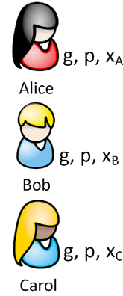
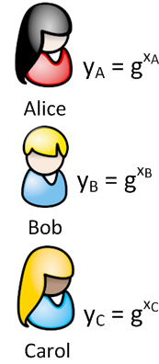
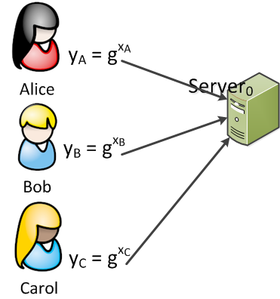
D3 Shuffle

Slide 21
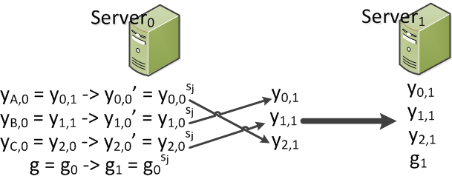
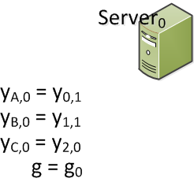
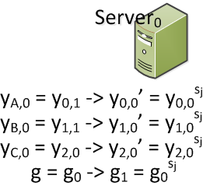
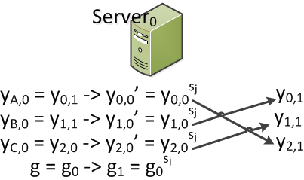
D3 Shuffle

Slide 22
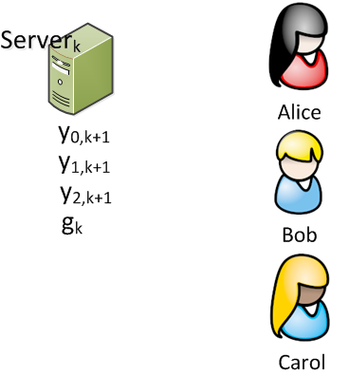
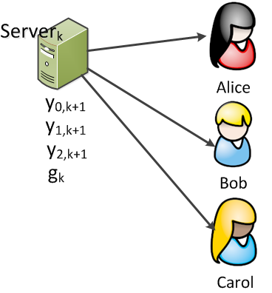
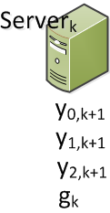
D3 Shuffle

Slide 23




D3 Shuffle

Slide 24
D3 Shuffle Accountability
Two approaches: Cut-and-choose and NI-ZKP
Cut-and-choose
  Each server performs several encryptions and permutations
  Releases the output of each encryption-permutation round
  Servers use a distributed RNG to determine which round secrets to release
  Anyone (namely, servers) can verify proper behavior for the rounds for the secrets that were released
NI-ZKP
  Each server produces a NI-ZKP transcript and transmits with their shuffle output
  The final server distributes out the resulting message and the set of NI-ZKP
  Transmits to clients who can also verify the NI-ZKP

Slide 25
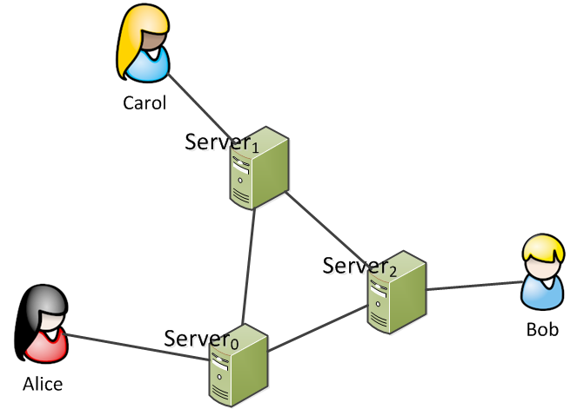
D3 Client Connectivity
Shuffle
  Clients submit public key
  Disconnect
  Connect at a later time to retrieve set of anonymized public keys
DC-net
  Clients can join any time, only need to learn the nonce
  Servers quickly adjust Ciphertext to client online state

Slide 26
Organization
Motivation and Goals
Existing Approaches
Introduction to Dissent
Trust Models
D3 = Anytrust(Dissent) + ε
Analysis
Future Work / Parallel Projects

Slide 27
Analytical Comparison
 | Feature | Dissent | D3
Shuffle | Comm | O(N) serial steps | O(1)
 | Anon | O(K), K = honest members | O(K), K = honest members, assuming 1 honest server
DC-net | Comm | O(N²) messages O(N²) shared secrets | O(N) messages O(N) shared secrets
 | Anon | O(K), K = honest members | O(K), K = honest members, assuming 1 honest server

Slide 28
PlanetLab Experiences
10 servers running at Yale
100+ clients running on PlanetLab
PlanetLab bad behavior
  Random socket disconnects (half-open TCP sockets)
  Large data segments stall connection
  Slow processing of ciphertext ( < 1 s locally, > 60 s)
Evaluation over a long period (hours to days)
Protocol restarts for new joins and after 10 mins for disconnecting clients
 | Shuffle (s) | DC-net (s) | Participation
Dissent | 30.56 +/- 55.52 | 109.38 +/- 63.38 | 100%
D3 | 8.33 +/- 3.86 | 1.59 +/- 2.84 | 97.7% +/- 3.8

Slide 29
Organization
Motivation and Goals
Existing Approaches
Introduction to Dissent
Trust Models
D3 = Anytrust(Dissent) + ε
Analysis
Future Work / Parallel Projects

Slide 30
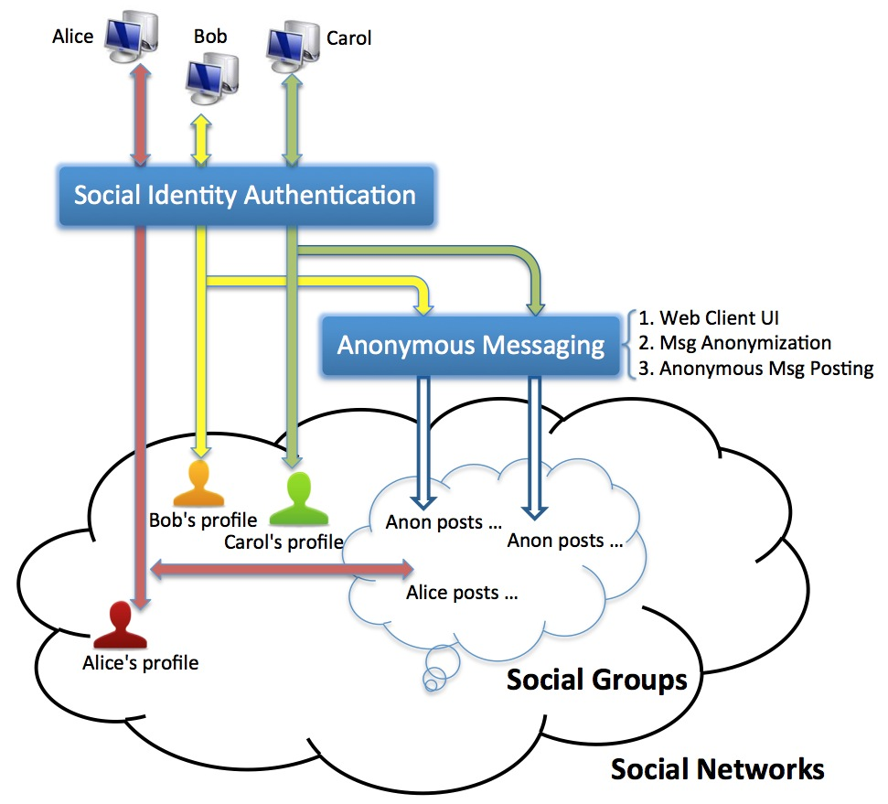
Integration with Social Networks

Slide 31
Future Work in Dissent
Accountability is online, requires additional steps after the protocol has completed
Practical use in real environments – Such as using WIFI enabled smart phones
Anonymity boxes – isolated environments running within a virtual machine isolating the user’s private information from the anonymity network
Prevent single identity Sybil attacks by limiting members of a group to a single running client instance

Slide 32
Anonymity System Goals
Sender anonymity – a message cannot be traced back to the submitting member
Integrity – messages are received unmodified
Accountability – misbehaving members will be third-party verifiably identified
Scalablility
  Support 100s to 1,000s of active participants within a single anonymity set
  “short” delays – time between message transmission and reception should be on the order of seconds
  Churn should have limited impact

Slide 33
D3 Features
Sender anonymity – a message cannot be traced back to the submitting member
Integrity – messages are received unmodified
Accountability – misbehaving members will be third-party verifiably identified
Scalablility
  Support 100s* of active participants within a single anonymity set
  “short” delays – time between message transmission and reception should be on the order of seconds
  Churn should have limited impact

Slide 34
Finished!
Thanks, questions?

Slide 35
Extra slides

Slide 36
Existing Approaches
Method | Weakness
Mix-Nets, Tor | Traffic analysis attacks
Group / Ring Signatures | Traffic analysis attacks
Voting Protocols | Fixed-length messages
DC Nets | Anonymous DoS attacks
Dissent | Intolerant to churn / long delays between msgs
Herbivore | Small anonymity set, traffic analysis attacks

Slide 37
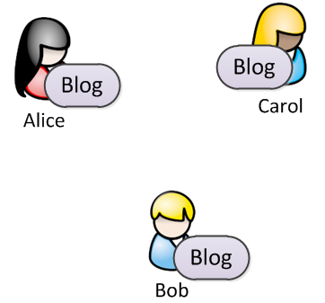
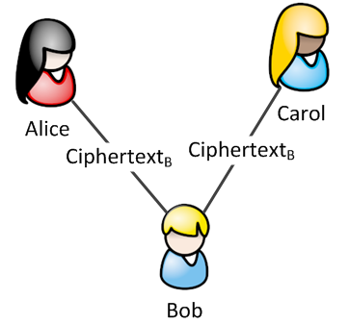
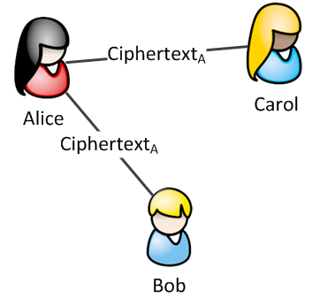
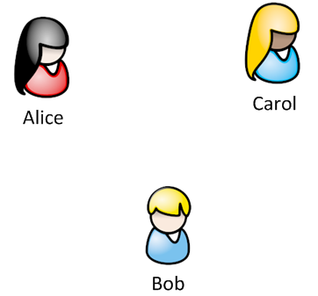
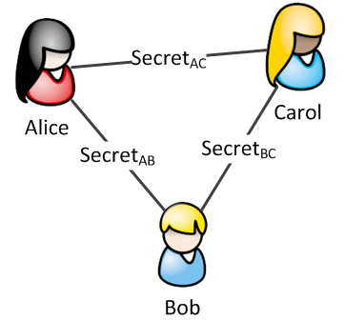
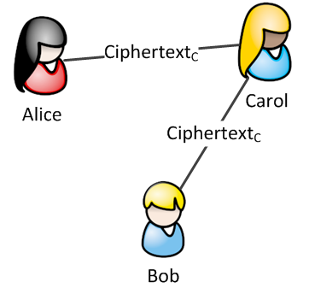
Dining Cryptographers Network
Alice, Bob, and Carol join an anonymous blog
  All of them are subscribers
  One of them is the author (Bob)
Members have shared secrets
Protocol: Alice’s perspective (sub.)
  Generate Ciphertext_{AB} = RNG(Secret_{AB}, Length)
  Generate Ciphertext_{AC} = RNG(Secret_{AC}, Length)
  Ciphertext_{A} = Ciphertext_{AB} XOR Ciphertext_{AC}
Protocol: Bob’s perspective (author)
  Generate: Ciphertext_{B} <= Ciphertext_{AB} XOR Ciphertext_{BC}
  Set Ciphertext_{B} <= Ciphertext_{B} XOR blog
All members exchange ciphertexts reproducing blog
  Accumulate Ciphertext_{A,} Ciphertext_{B,} and Ciphertext_{C}
  Blob <= Ciphertext_{A} XOR Ciphertext_{B} XOR Ciphertext_{C}

Slide 38
D3 DC-net Accountability
In D3 DC-net, a malicious bit flip which has resulted in a 0 -> 1 in the cleartext can be used to generate an accusation
  In a DC-net, client requests accusation shuffle
  In shuffle, client specifies the bit
Servers share
  The bit matched to each client
  The original client ciphertexts for that round
Each server can then validate
  The server sent out the correct bit
  The client sent out the correct bit
For a mismatch, either the client or server can release the shared secret with a NI-ZKP to verify the secert
  Members can regenerate the ciphertext
  Bit in ciphertext will match honest client or honest server

Slide 39
Dissent – A Practical DC-net
A group of members want to participate in an anonymous message round, exchange messages anonymously, or receive a message
Each member first participates in a fixed length shuffle to exchange anonymous RNG seeds and anonymous signing keys
The shuffle’s final permutation reveals the seeds and keys assigning the owner the index within that permutation
The seeds are then used to construct DC-net messages with slot ownership verified by the signature of the key owner
A misbehavior results in a shuffle, where the owner of the slot reveals verifiable proof of disruption and the identity of the disruptor

Slide 40
D3 – Dissent V3
D3 = Anytrust(Dissent) = Anytrust(Shuffle) + Anytrust(DC-net)
D3 Shuffle
  Any member (client) can transmit a ciphertext
  The working subset (servers) performs the shuffle
  Moves O(N) serial communication steps to O(1) for fixed set of servers
D3 DC-net
  Each client shares a secret with each server used to generate ciphertexts
  A client connects with one server and transmits their XOR collection of ciphertexts
  Each server shares with every other server the set of clients who have submitted messages
  Each server generates a matching ciphertext and commits to it via exchanges with other servers
  Each server then shares their accumulated ciphertexts
  The servers each sign the cleartext messages and shares it with other servers
  The servers distribute the cleartext messages along with the signatures

Slide 41
D3 – DC-net
Client actions:
  Share a secret via Diffie-Hellman with each server
  In each round, generate a ciphertext for each server
  Submit the composite ciphertext to a single server
Server actions:
  Wait up to a specified time period for client ciphertexts
  Notify all servers of clients who submitted a ciphertext
  Each server generates a ciphertext to match the online client set
  Servers commit with each other before releasing ciphertext
  Each server signs the final cleartext
  After accumulating the signatures, the server pushes the cleartext and signatures to the clients

Slide 42
D3 Shuffle
DC-net only requires keys
  No need for inner encryption of shuffle data (no anonymity lost if shuffle is compromised)
  Shuffle still requires go / no-go, we need a verifiable shuffle
Neff proposed a key shuffle to prevent voting fraud!
Based upon El Gamal (DSA) keys
  Private key x mod q
  Public key y = g^{x} mod p
Each server encrypts the set of keys and the generator (g) and permutes their order
  Public key: y’ = (g^{x})^{s}
  Generator: g’ = g^{s}
After k servers
  Public keys become y_{k} = g_{k}^{x}
  Each participant can easily locate their key, but no one else can

Slide 43
On the Wire
Client’s (Carol’s):
  Slot cleartext = RND(seed, (seed, (accusation, (nonce, next msg length, msg), signature)))
  Ciphertext_{C} = Ciphertext_{C,0} XOR Ciphertext_{C,1} XOR Ciphertext_{C,1} XOR (0, …, 0, Slot cleartext, 0, …, 0)
  Cleartext = Cleartext, Signature₀, Signature₁, Signature₂
Server₀’s:
  Client list: (Alice)
  Ciphertext₀ = Ciphertext_{A} XOR Ciphertext_{A,0} XOR Ciphertext_{B,0} XOR Ciphertext_{C,0}
  Commit₀ = Hash(Ciphertext₀)
  Cleartext = Ciphertext₀ XOR Ciphertext₁ XOR Ciphertext₂
  Signature = {Cleartext}_{Key0}

Slide 44
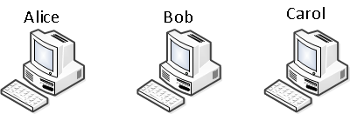
The Dissent Model

Slide 45
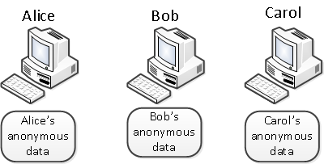
The Dissent Model

Slide 46
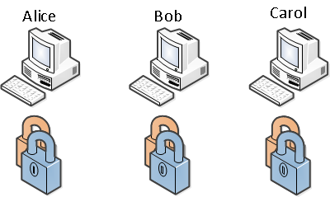
The Dissent Model

Slide 47
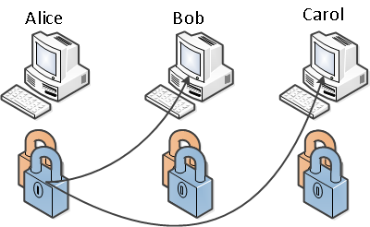
The Dissent Model

Slide 48
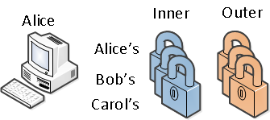
The Dissent Model

Slide 49
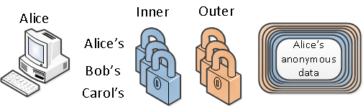
The Dissent Model

Slide 50
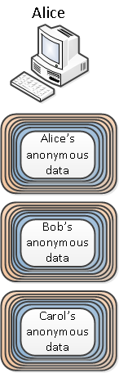
The Dissent Model

Slide 51
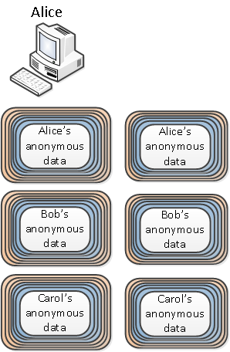
The Dissent Model

Slide 52
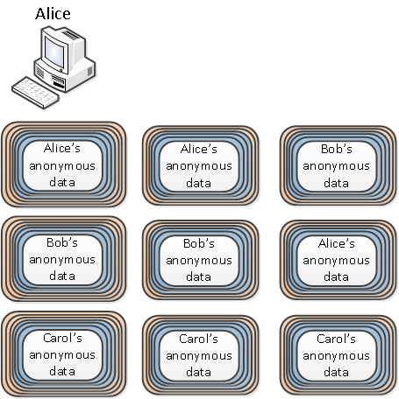
The Dissent Model

Slide 53
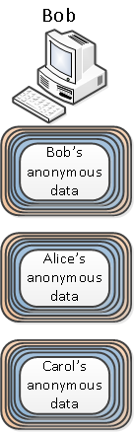
The Dissent Model

Slide 54
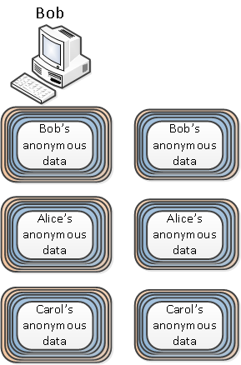
The Dissent Model

Slide 55
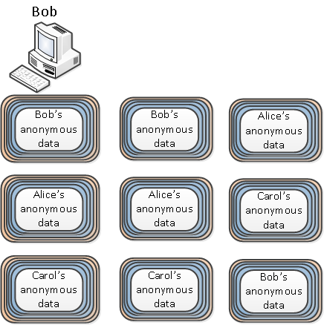
The Dissent Model

Slide 56
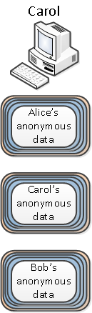
The Dissent Model

Slide 57
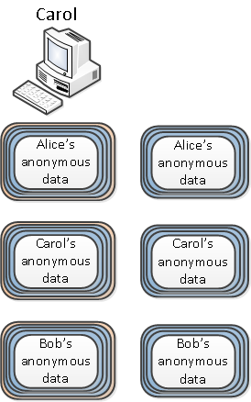
The Dissent Model

Slide 58
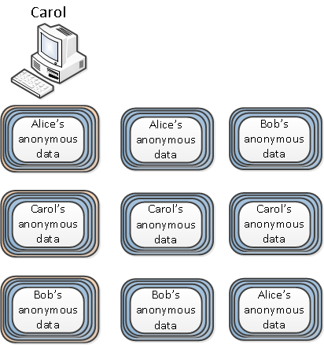
The Dissent Model

Slide 59
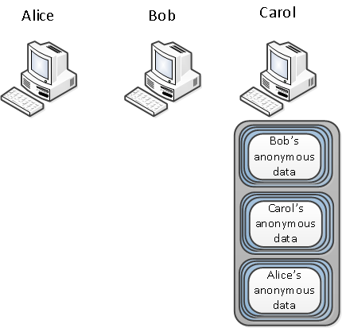
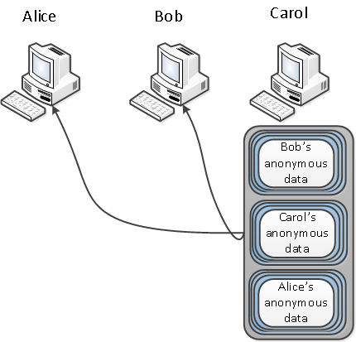
The Dissent Model

Slide 60
The Dissent Model

Slide 61
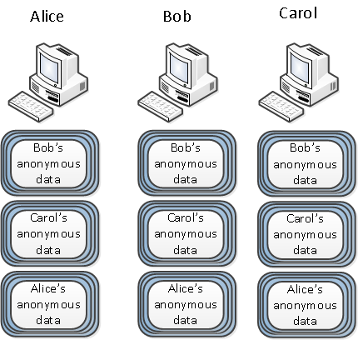
The Dissent Model

Slide 62
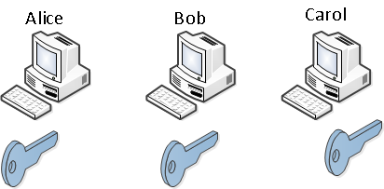
The Dissent Model

Slide 63
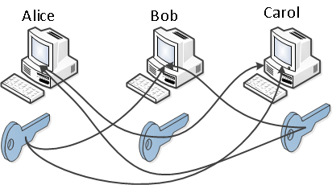
The Dissent Model

Slide 64
The Dissent Model

Slide 65
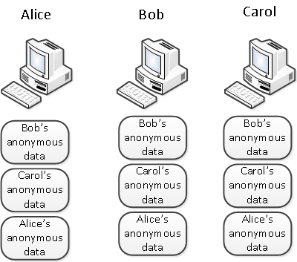
The Dissent Model

Slide 66

The Dissent Model

Slide 67
The Dissent Model

Slide 68

The Dissent Model

Slide 69
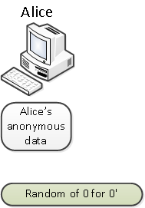
The Dissent Model

Slide 70
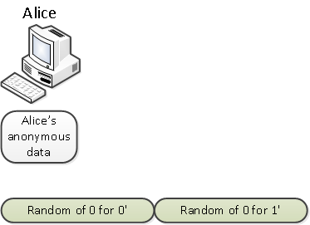
The Dissent Model

Slide 71
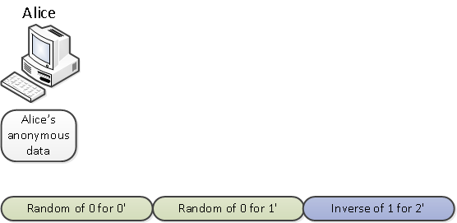
The Dissent Model

Slide 72
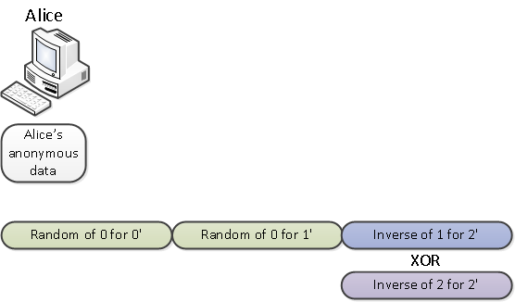
The Dissent Model

Slide 73
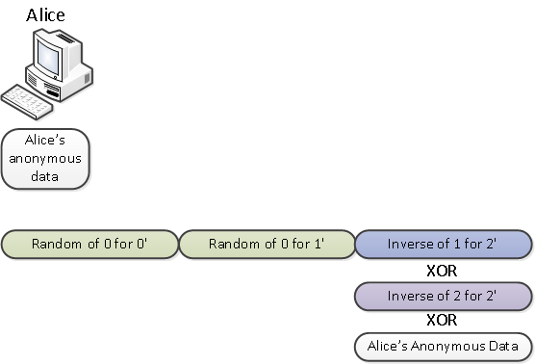
The Dissent Model

Slide 74
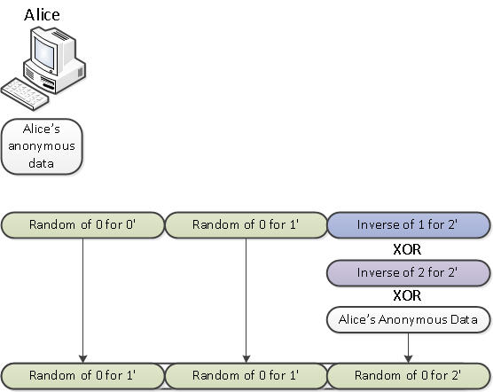
The Dissent Model

Slide 75
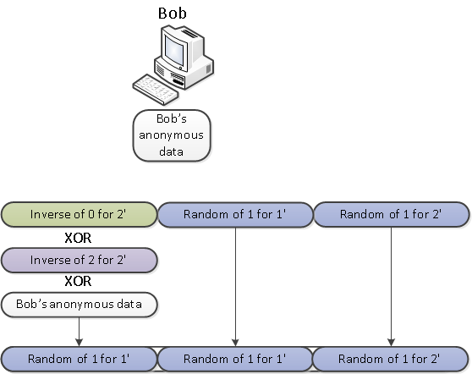
The Dissent Model

Slide 76
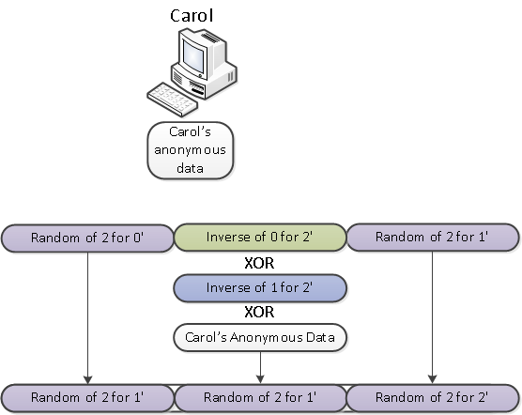
The Dissent Model

Slide 77
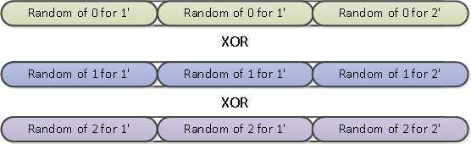
The Dissent Model

Slide 78
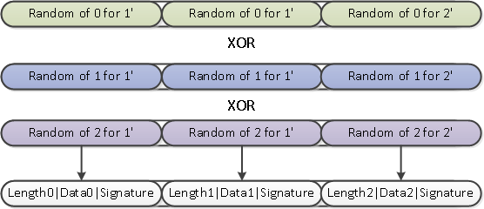
The Dissent Model

Slide 79
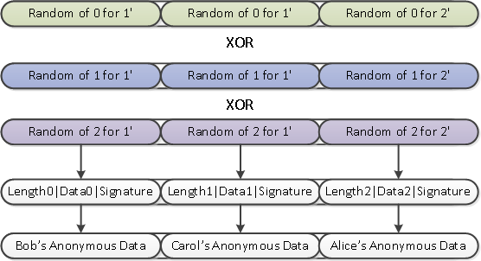
The Dissent Model

