Slide 1
Grid Appliance – On the Design of
Self-Organizing, Decentralized Grids
David Wolinsky, Arjun Prakash, and Renato Figueiredo
ACIS Lab at the University of Florida

Slide 2
Background
Inefficient use of resources
  Ad hoc / word of mouth scheduling
  Varying resource availability in different labs
Why not use grid / cluster middleware
  For local use requires Operating System and Middleware expertise and patience
  For wide area use requires Security and Networking expertise and even more patience
Solution – Grid Appliance
  Self-configuring framework for grid computing
  Provides decentralized VPN, P2P discovery system, user services

Slide 3
Grid Appliance Overview
Configure the Grid through group-based interfaces
P2P overlay supports NAT traversal and assists in automated discovery of resources
Decentralized VPN built on top of P2P to provide common address space for all-to-all connectivity
Complete systems available as virtual machine appliances and cloud instances and installable via package managers

Slide 4
Typical Grid Configuration
Workers – Machine dedicated for running jobs
Clients / Submitters – Machines used to queue jobs into the grid
Manager / Server / Master – Manages the connectivity between clients and workers
Examples
  Hierarchical / Centralized – One common manager / client per site with multiple workers at each site
  Individual submission sites per user, managers per site with multiple workers
Workers and Clients must find the Manager(s) and multiple Managers may want to find each other

Slide 5
Traditional Grid Setup
Start a manager node at each site
Start a submission node at each site
  Add manager IP addresses to each submission node
  Add users to submission node
  Set permissions and security considerations
Start worker nodes and connect to a specific manager
Challenges
  Network connectivity amongst nodes, requires some bidirectional connectivity
  Static IP addresses / DNS recommended or require reconfiguration, whenever there is a change
  Adding a new site requires reconfiguration at each site
  Each site must provide resources for each user
  Difficult to provide connectivity for external users

Slide 6
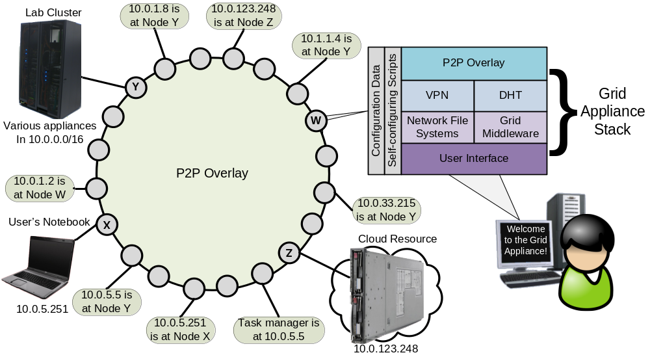
Grid Appliance Grid

Slide 7
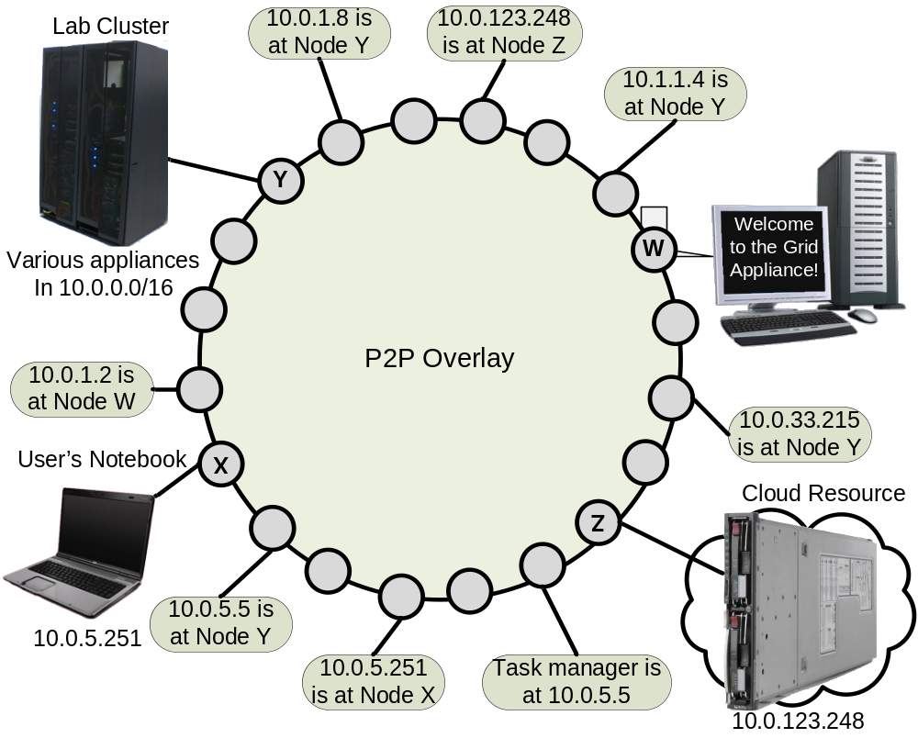
Using a DHT to Configure
Distributed Hash Table (DHT)
Decentralized structure for storing values at keys
Log N communication cost
Great for decentralized discovery
  Manager nodes store their IP addresses in DHT – DHT[managers] += IP
  Client / workers query DHT to obtain list of managers
  Clients can query later to add more manager nodes

Slide 8
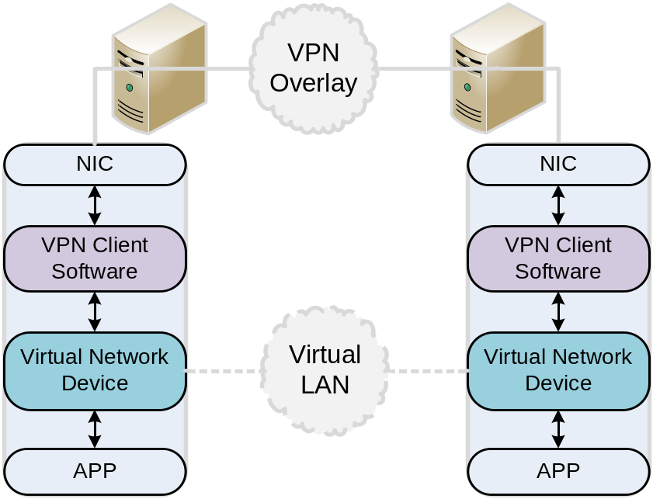
P2P VPN – IPOP – Overview
A VN framework
Supports peer discovery (address resolution) through a DHT and social
networks (SocialVPN)
Written in C#, portable without recompilation

Slide 9
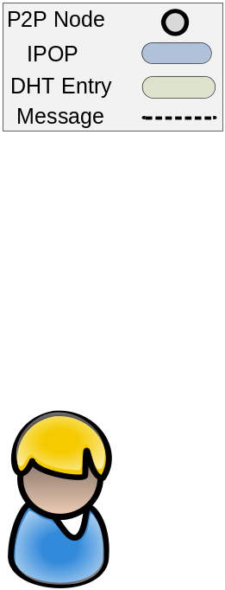
IPOP’s P2P Usage

Slide 10
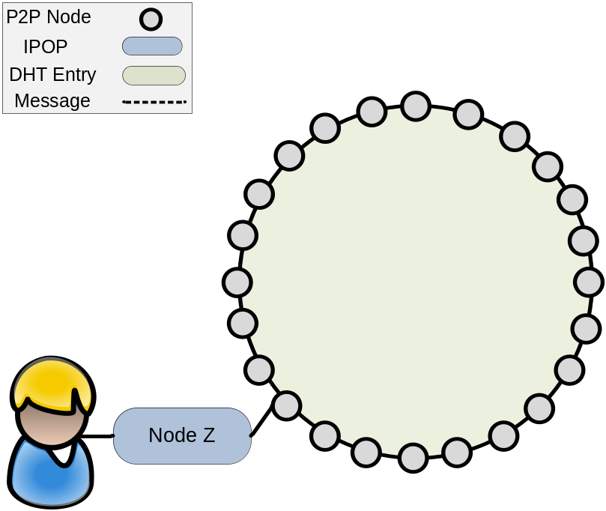
IPOP’s P2P Usage
All nodes join a DHT overlay
Decentralized NAT traversal
  Hole punching
  Relaying across overlay

Slide 11
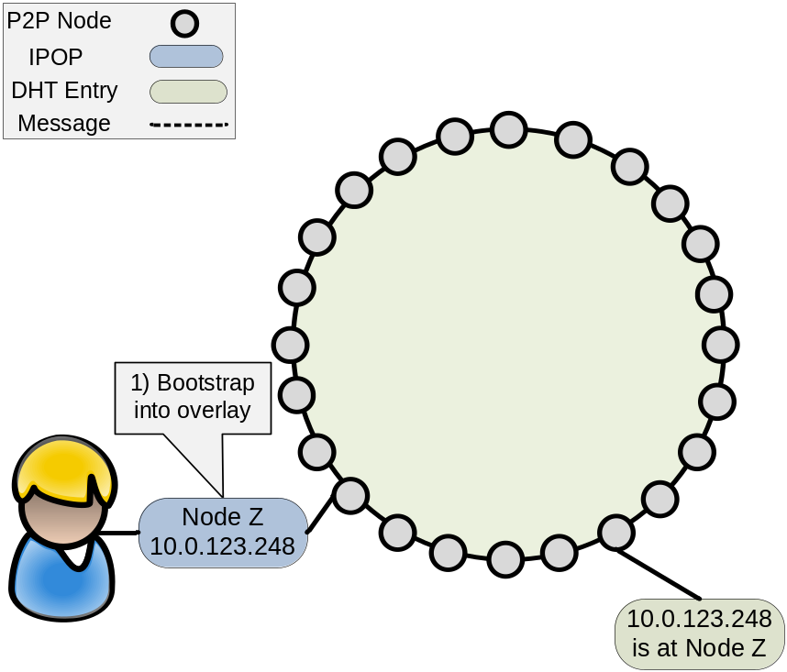
IPOP’s P2P Usage
All nodes join a DHT P2P
Decentralized NAT traversal
  Hole punching
  Relaying across overlay
IP Mapping => DHT[IP] = P2P

Slide 12
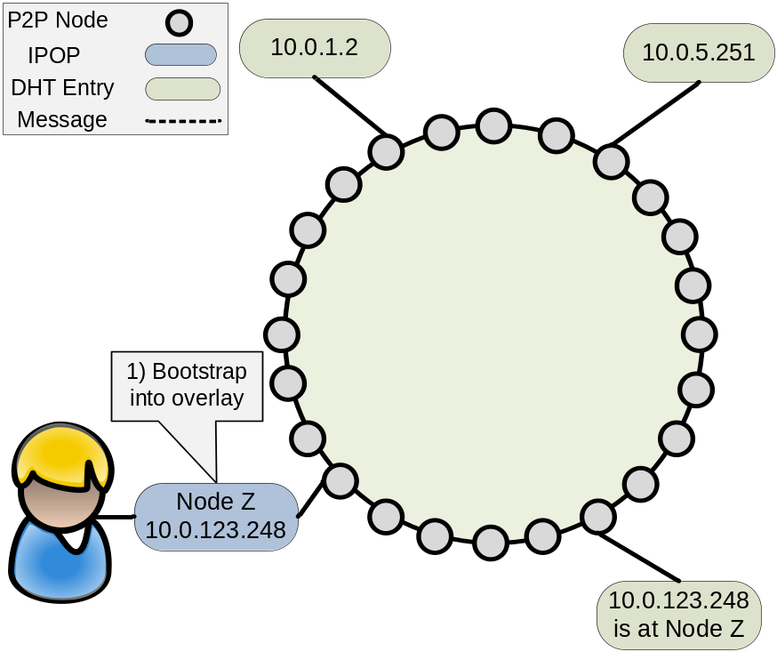
IPOP’s P2P Usage
All nodes join a DHT P2P
Decentralized NAT traversal
  Hole punching
  Relaying across overlay
IP Mapping => DHT[IP] = P2P
Connecting two peers:
  Resolve IP to a P2P Address

Slide 13
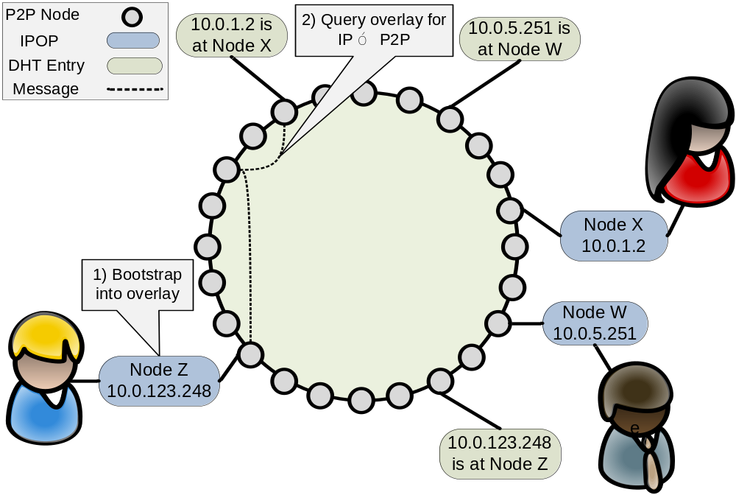
IPOP’s P2P Usage
All nodes join a DHT P2P
Decentralized NAT traversal
  Hole punching
  Relaying across overlay
IP Mapping => DHT[IP] = P2P
Connecting two peers:
  Resolve IP to a P2P Address

Slide 14

IPOP’s P2P Usage
All nodes join a DHT P2P
Decentralized NAT traversal
  Hole punching
  Relaying across overlay
IP Mapping => DHT[IP] = P2P
Connecting two peers:
  Resolve IP to a P2P Address
  Form direct connection between the two parties

Slide 15
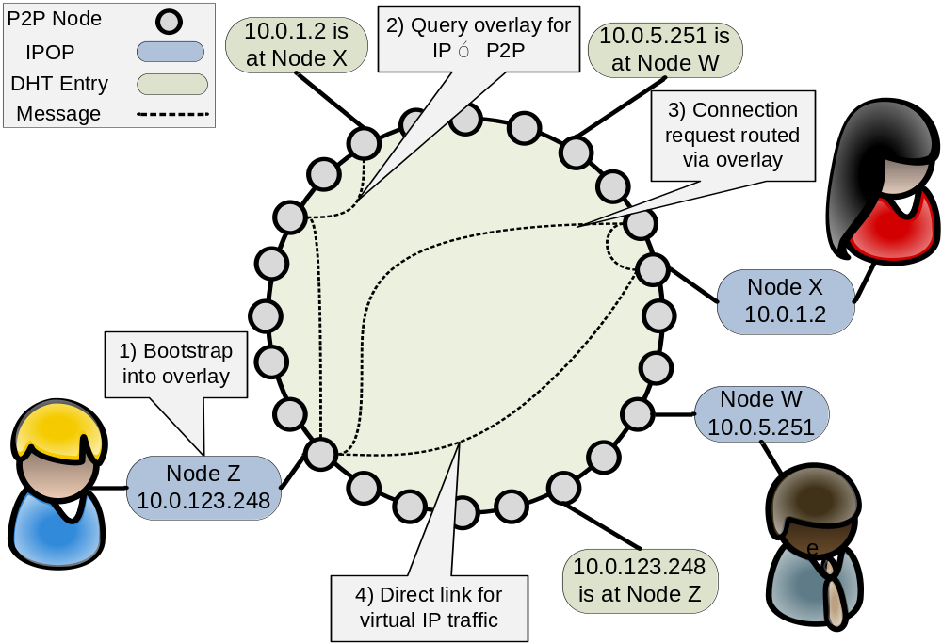
IPOP’s P2P Usage
All nodes join a DHT P2P
Decentralized NAT traversal
  Hole punching
  Relaying across overlay
IP Mapping => DHT[IP] = P2P
Connecting two peers:
  Resolve IP to a P2P Address
  Form direct connection between the two parties

Slide 16
User Configuration of the Grid
Reuse group concept from online social networks such as Facebook and Google Groups
A grid is represented by a single group with each organization or indivisible unit represented by a subgroup
Upon joining (creating) a grid group and an organization users can download configuration files
  Individual configuration files for managers, workers, and submission nodes
  Specifies the users identity and can be used to automatically obtain a signed certificate for the user and thus can be used on multiple machines

Slide 17
Comparison to a Statically Configured Grid
Connect resources from EC2 US East Coast, University of Florida, and FutureGrid’s Eucalyptus at Indiana University
EC2 and Indiana University has a cone NAT and University of Florida has a port restricted cone NAT
Grid Middleware – Condor
Static grid was preconfigured, each node already has a OpenVPN security configuration and knows the IP address of the head node, limited to the configuration of Condor
Grid Appliance grid already has configuration file but must connect to P2P overlay, discover manager, and establish a P2P connection to the manager

Slide 18
Evaluation
50 Resources at each site
Time for all nodes to register with manager
Time for a submission site to connect with each node and the node return the job results (5 minute sleep job)
Negligible overhead for using P2P technologies for configuration and addressing NAT connectivity issues
 | Time to Connect (s) | Time to Run Job (s)
Static | 17 | 389
Grid Appliance | 111 | 451

Slide 19
Conclusions
DHT can be useful for decentralized resource configuration
  Grid Middleware manager discovery
  P2P VPN node discovery
P2P VPN can provide connectivity when dealing with NAT constraints
Approach has small self-configuration overhead
Freely available at http://www.grid-appliance.org

Slide 20


Motivation

Slide 21
